Slide 1
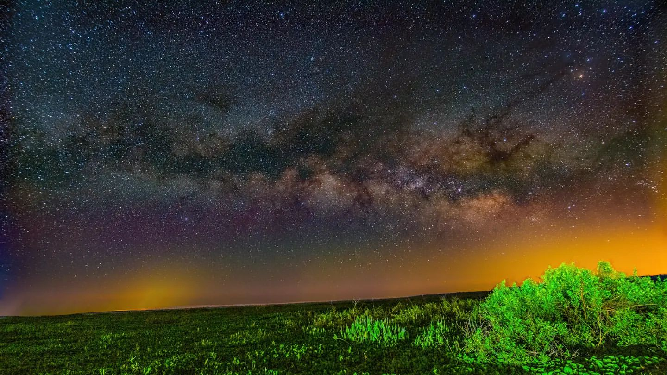
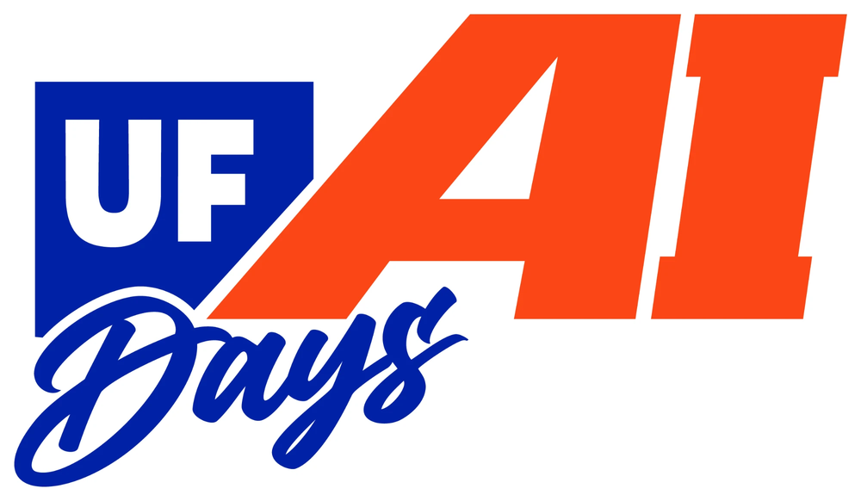
UF AI DAYS · OCT. 27, 2026
AI Research, Teaching, and Learning Day
Restoring the Milky Way
Scaling AI-assisted light pollution planning across North Central Florida
Jay Rosen · jayrosen@ufl.edu
Research Software Engineer III, University of Florida College of Education
Photo: Milky Way and urban skyglow over Paynes Prairie, 2022. Jay Rosen
Notes:
[0:00–0:25]
Good afternoon, I'm Jay Rosen. I took this photograph at Paynes Prairie, about fifteen minutes from campus. You can see the Milky Way, and the yellow glow of our cities on the horizon.
Today I'll show how satellite data, AI, and simulation can help communities make choices that bring darker skies back to North Central Florida.

Slide 2
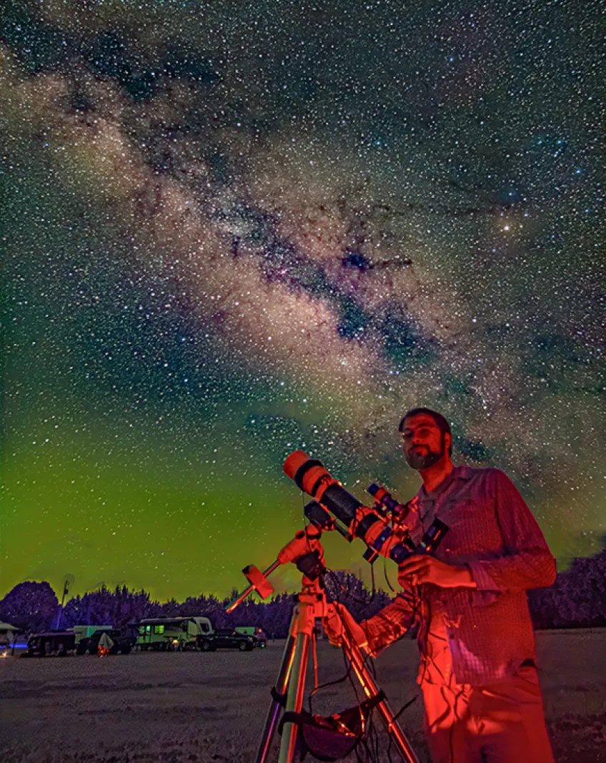
INTRODUCTION
About me: from light art to light pollution
Light art, 15 years: light, mirrors, and increasingly technological media
Before UF: founder and CEO, Space Age Mining Corp. (HPC)
At UF: Research Software Engineer III, College of Education
Astrophotography since 2020: photos on state park websites
NASA Space Apps: 2× Kennedy Space Center winner, global nominee, judge
Outside UF: Board of Directors, Alachua Astronomy Club
Civic service on City of Gainesville and Alachua County boards
Full-spectrum self-portrait at the Chiefland Astronomy Village, April 2024. Photo: Jay Rosen
Jay Rosen · Restoring the Milky Way · UF AI Days · October 27, 2026
2
Notes:
[0:25–1:16]
A little background on how I got here. I'm a UF College of the Arts alumnus, and I've spent about fifteen years working with light as an artist; as an Undergraduate Scholar I studied Light and Space art, including abroad in Europe.
Before UF, I founded Space Age Mining, a high-performance computing company. Now I'm a research software engineer in the College of Education.
Astrophotography brought it together: light art made with light from the cosmos, much of it full-spectrum, like this self-portrait.
I've had two NASA Space Apps wins at Kennedy Space Center and a global nomination, and this year I'm a judge. I also serve on the Alachua Astronomy Club board and on city and county boards.

Slide 3
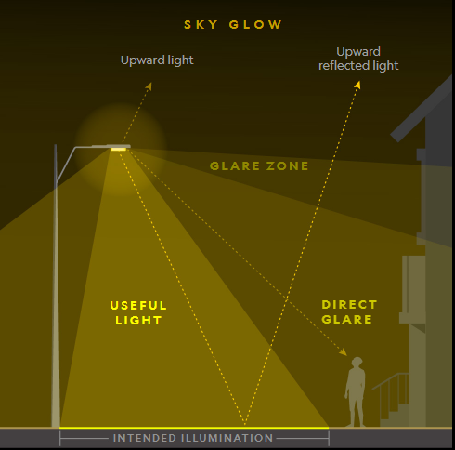
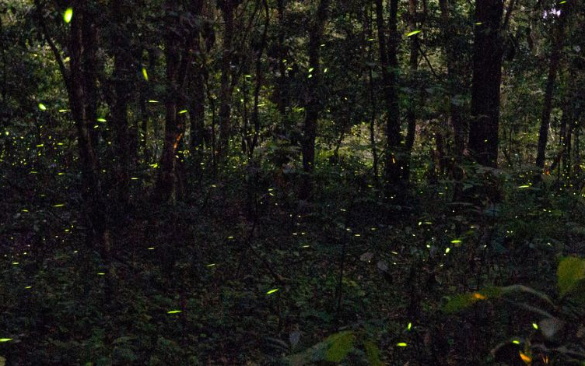
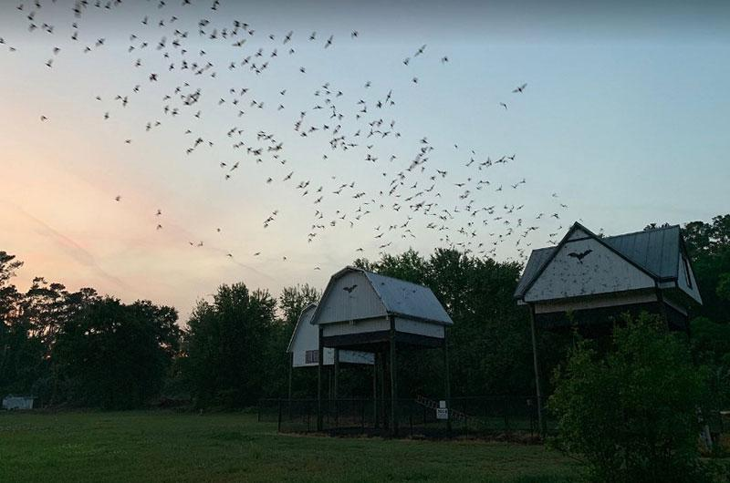
THE PROBLEM
What is light pollution?
Light pollution: excessive, misdirected or obtrusive artificial light at night (ALAN)
Why it matters
Wildlife, as at Paynes Prairie: insects drawn to their deaths, frogs calling less, night-migrating birds thrown off course, bats losing dark habitat
People: blue-rich light at night suppresses melatonin and disrupts sleep
Energy: light sent into the sky is paid for and wasted
The night sky: skyglow hides the Milky Way, even at UF's observatories
Skyglow: the dome over a city that washes out the stars
Light trespass: spill onto neighbors and habitat
Glare: brightness that hurts visibility
Excessive brightness: more light than the task needs
Image: Leeds Astronomical Society
Fireflies. Photo: UF IFAS
Bats at dusk. Photo: UF IFAS
Jay Rosen · Restoring the Milky Way · UF AI Days · October 27, 2026
3
Notes:
[1:16–1:45]
When I say light pollution, I don't just mean a city looks bright at night. I mean light going where it isn't needed: skyglow, glare, light trespass, or more brightness than a task requires.
And it affects more than astronomy. Artificial lighting can disrupt insects, birds, frogs, and bats in habitats like Paynes Prairie. Blue-rich light can affect sleep, and wasted light costs energy.

Slide 4
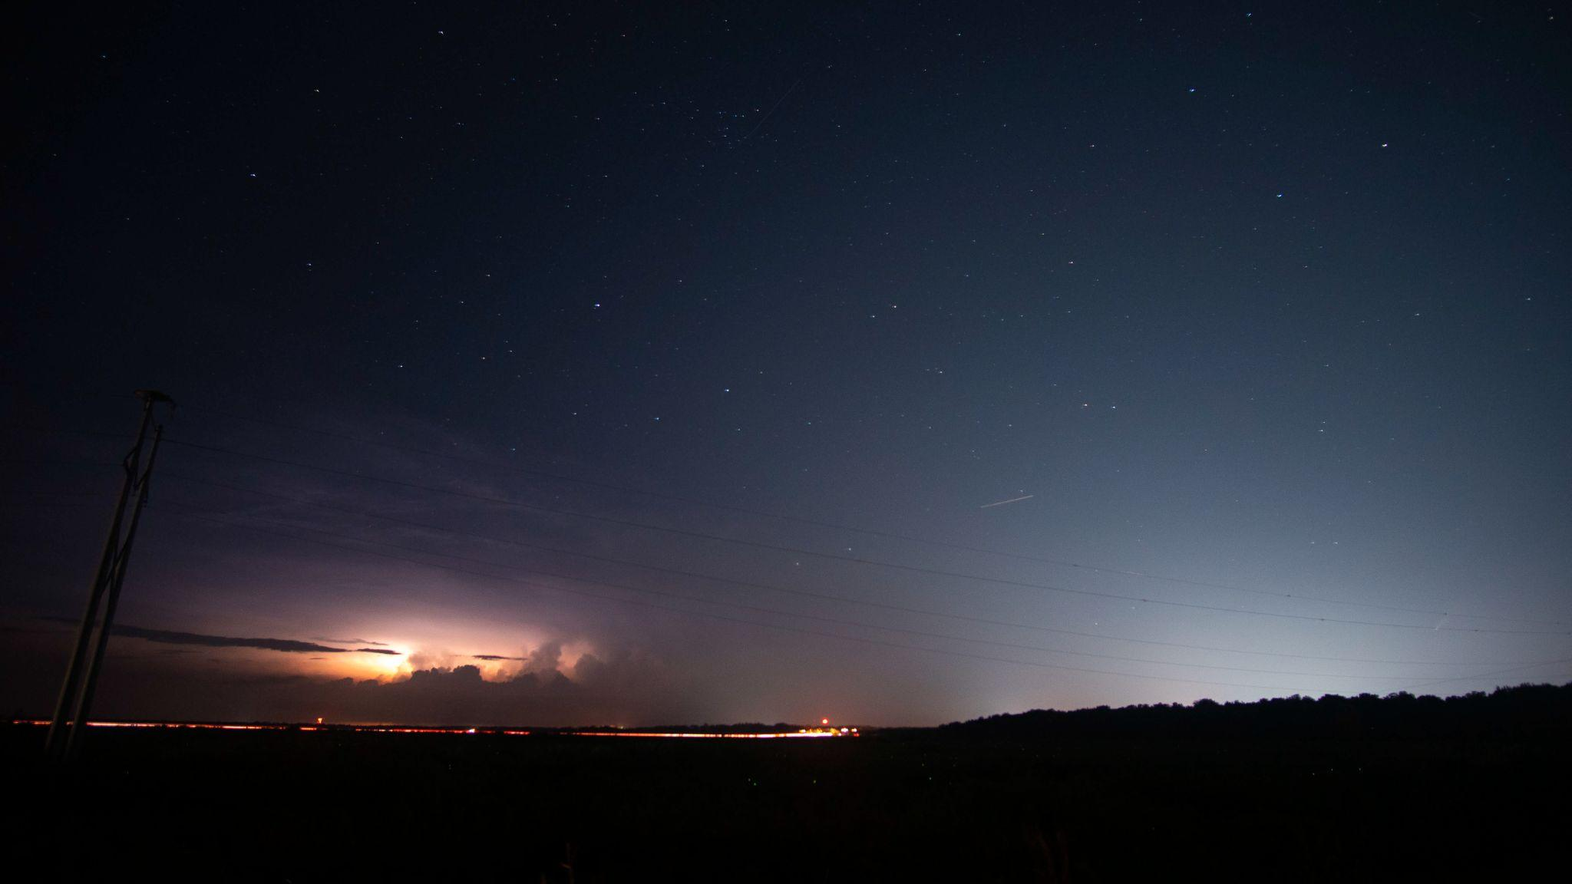
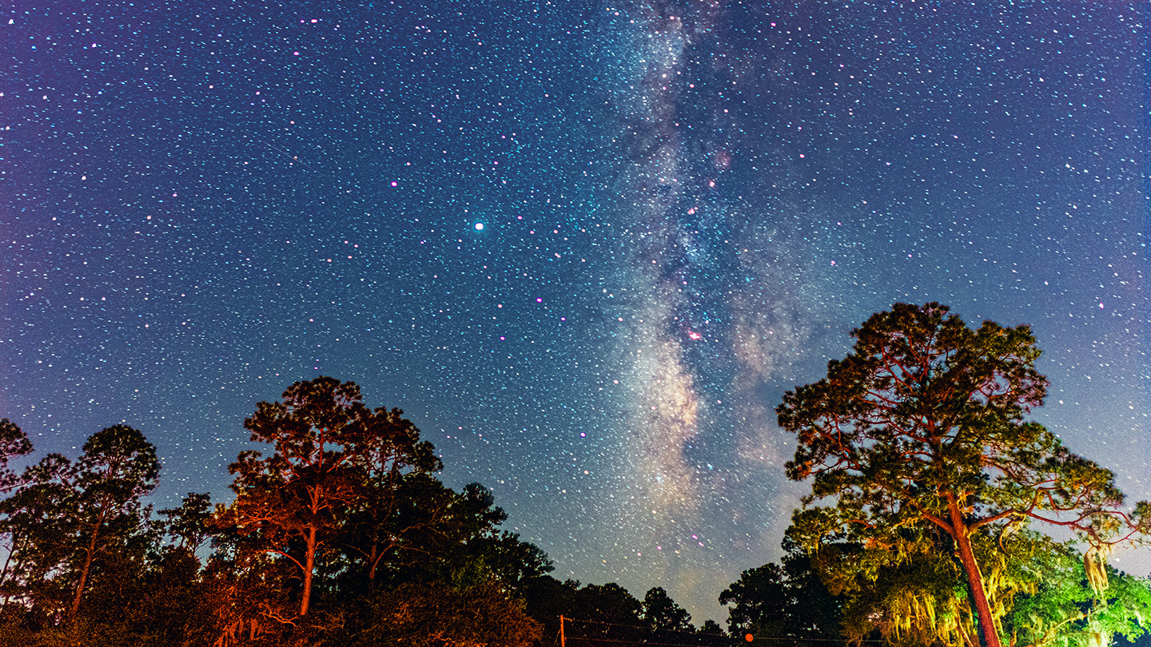
THE PROBLEM
Skyglow travels: one city's lights wash out a whole region
Paynes Prairie · Bortle 4, Gainesville dome. Gainesville's skyglow and Comet NEOWISE from Paynes Prairie, July 2020. Photo: Jay Rosen
Stephen C. Foster State Park, GA · Bortle 2. International Dark Sky Park, October 2020. Photo: Jay Rosen
Light scattered by air and haze brightens the sky tens of km away
Harms wildlife, sleep and health, and wastes energy
Threatens UF's dark sites: Rosemary Hill Observatory and Chiefland Astronomy Village
Preventable: shield, aim, warmer color, less brightness, dim late at night
Jay Rosen · Restoring the Milky Way · UF AI Days · October 27, 2026
4
Notes:
[1:45–2:17]
These are two of my photographs from 2020. On the left, Gainesville's light dome stretches over Paynes Prairie. On the right, Stephen C. Foster State Park in Georgia, an International Dark Sky Park, has a dramatically darker sky.
Skyglow travels tens of kilometers and crosses county lines, reaching observatories and rural communities far away. We know the fixes: shielding, warmer lights, dimming. But how do we compare them before spending public money?

Slide 5
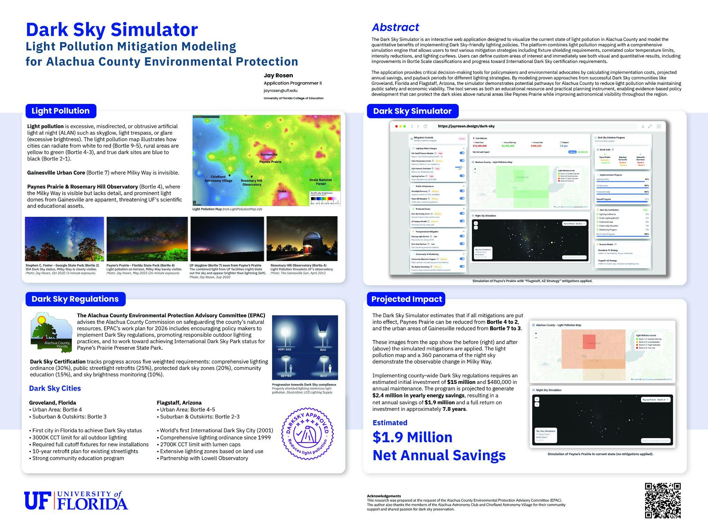
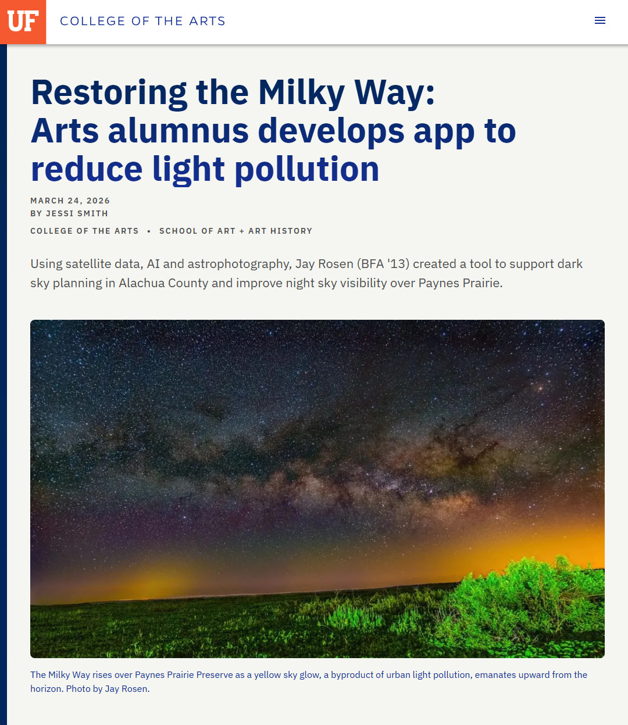
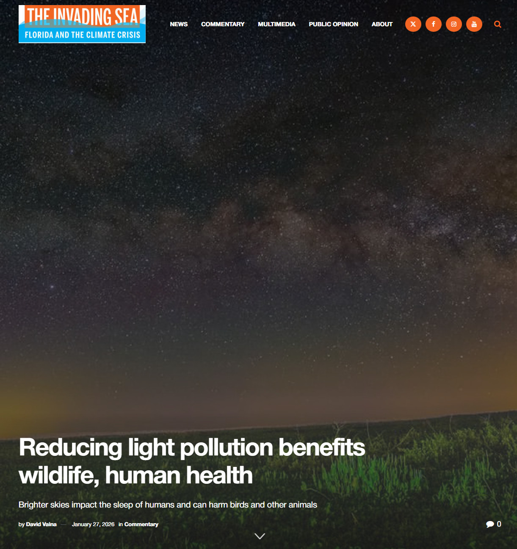
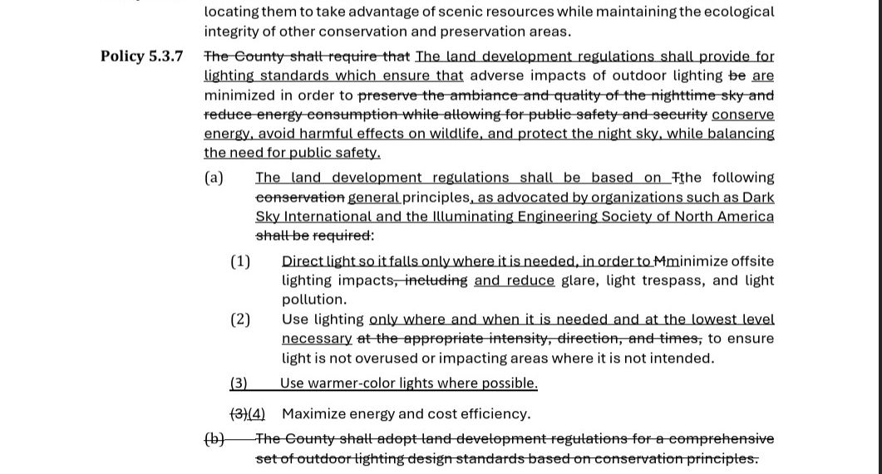
BACKSTORY
From astrophotography to county policy
2020–25 Photographing the night sky under Gainesville's light dome
Sep 2025 Public comment at Alachua County's advisory committee (EPAC)
Oct 2025 v1 simulator, built in a month: mitigations' economic and night-sky impact; debuted at UF Astraeus Space Research Day
Jan 2026 Presented the research and v1 simulator to EPAC; unanimous vote to pursue dark-sky policy
Feb–May 2026 Policy 5.3.7 amendment heard and sent to the state
Apr 2026 Dark Sky Week talks: Dr. Lada's UF class asks about a next observatory; the Alachua Astronomy Club asks about Levy
Sep 22, 2026 County Commission adopts it, unanimously
Now Expanding into Levy County; screening sites for UF's next observatory
UF College of the Arts, Mar 2026
v1 poster, UF Astraeus Space Research Day, Oct 2025
Policy 5.3.7 language, Feb 2026
The Invading Sea, Jan 2026
Jay Rosen · Restoring the Milky Way · UF AI Days · October 27, 2026
5
Notes:
[2:17–3:00]
For me, this started as an independent project. In September 2025, I spoke to Alachua County's Environmental Protection Advisory Committee about the light pollution I was photographing, then spent a month building a simulator of sky impacts and costs.
I debuted it at UF's Astraeus Space Research Day and took it back to the committee in January. They voted unanimously to pursue dark-sky policy.
During Dark Sky Week in April, I spoke to Dr. Elizabeth Lada's astrophotography class and the Alachua Astronomy Club. That raised two questions: where could UF build another observatory, and could we do this in Levy County?

Slide 6
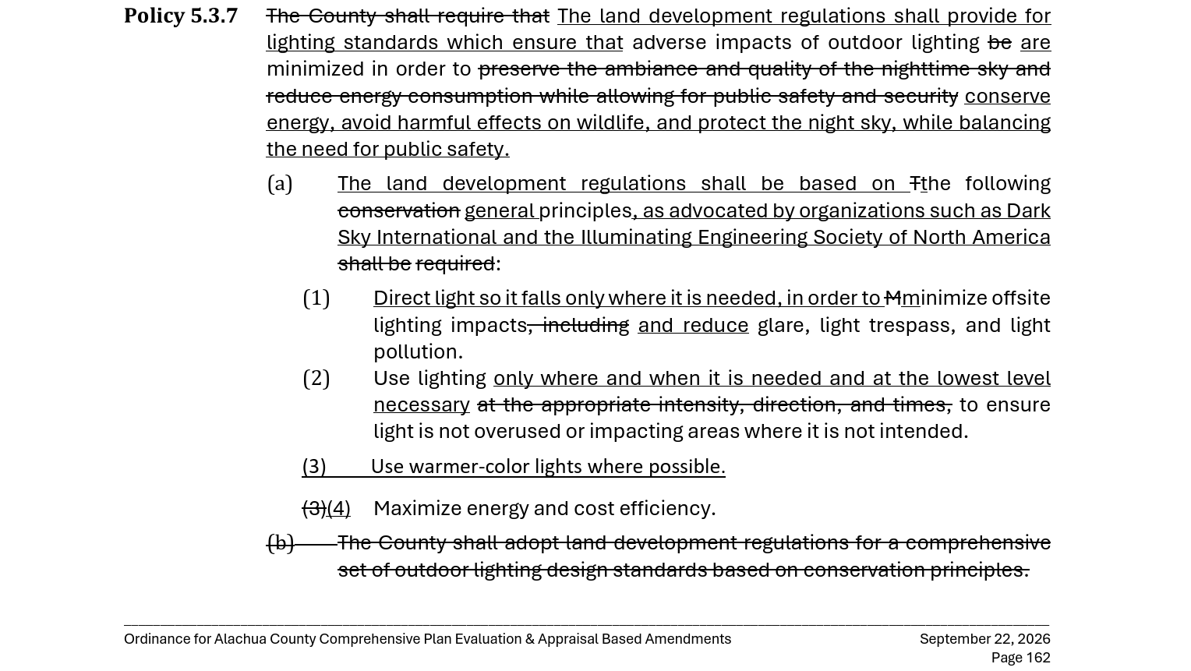
BACKSTORY
September 2026: dark-sky principles adopted
Alachua County's Comprehensive Plan update, Policy 5.3.7 (Conservation and Open Space Element)
Lighting standards must conserve energy, avoid harm to wildlife and protect the night sky, balanced with public safety
Based on principles from Dark Sky International and the Illuminating Engineering Society
Light only where and when needed, at the lowest level; warmer colors; energy and cost efficiency
Each one is a control in the simulator: shielding, dimming, the 3000 K cap, costs
Next: the land development code; in effect once the state finds it in compliance
Policy 5.3.7 as adopted: underlined text added, struck text removed. Alachua County ordinance amending the Comprehensive Plan (Evaluation & Appraisal amendments), September 2026, p. 162.
Jay Rosen · Restoring the Milky Way · UF AI Days · October 27, 2026
6
Notes:
[3:00–3:40]
Last month brought a milestone. On September 22, county commissioners unanimously adopted a broader Comprehensive Plan amendment package that included new dark-sky language under Policy 5.3.7.
The policy draws on DarkSky International and the Illuminating Engineering Society of North America. It balances protecting the night sky and wildlife with public safety and energy savings, through four principles: light only where it's needed, as little as necessary, warmer colors, and maximum efficiency.
Those are exactly the decisions the simulator evaluates. The next step is turning those principles into detailed lighting regulations.

Slide 7
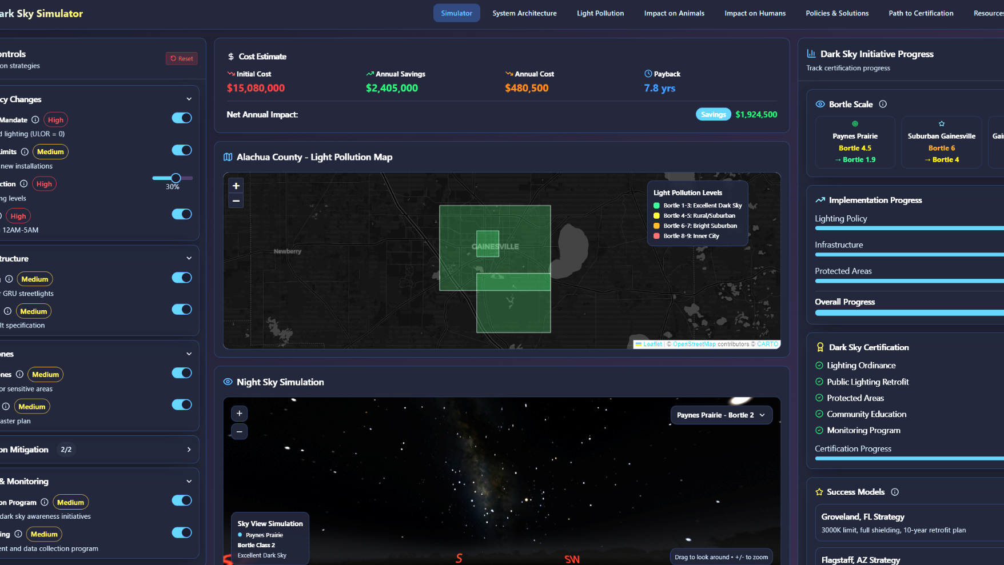
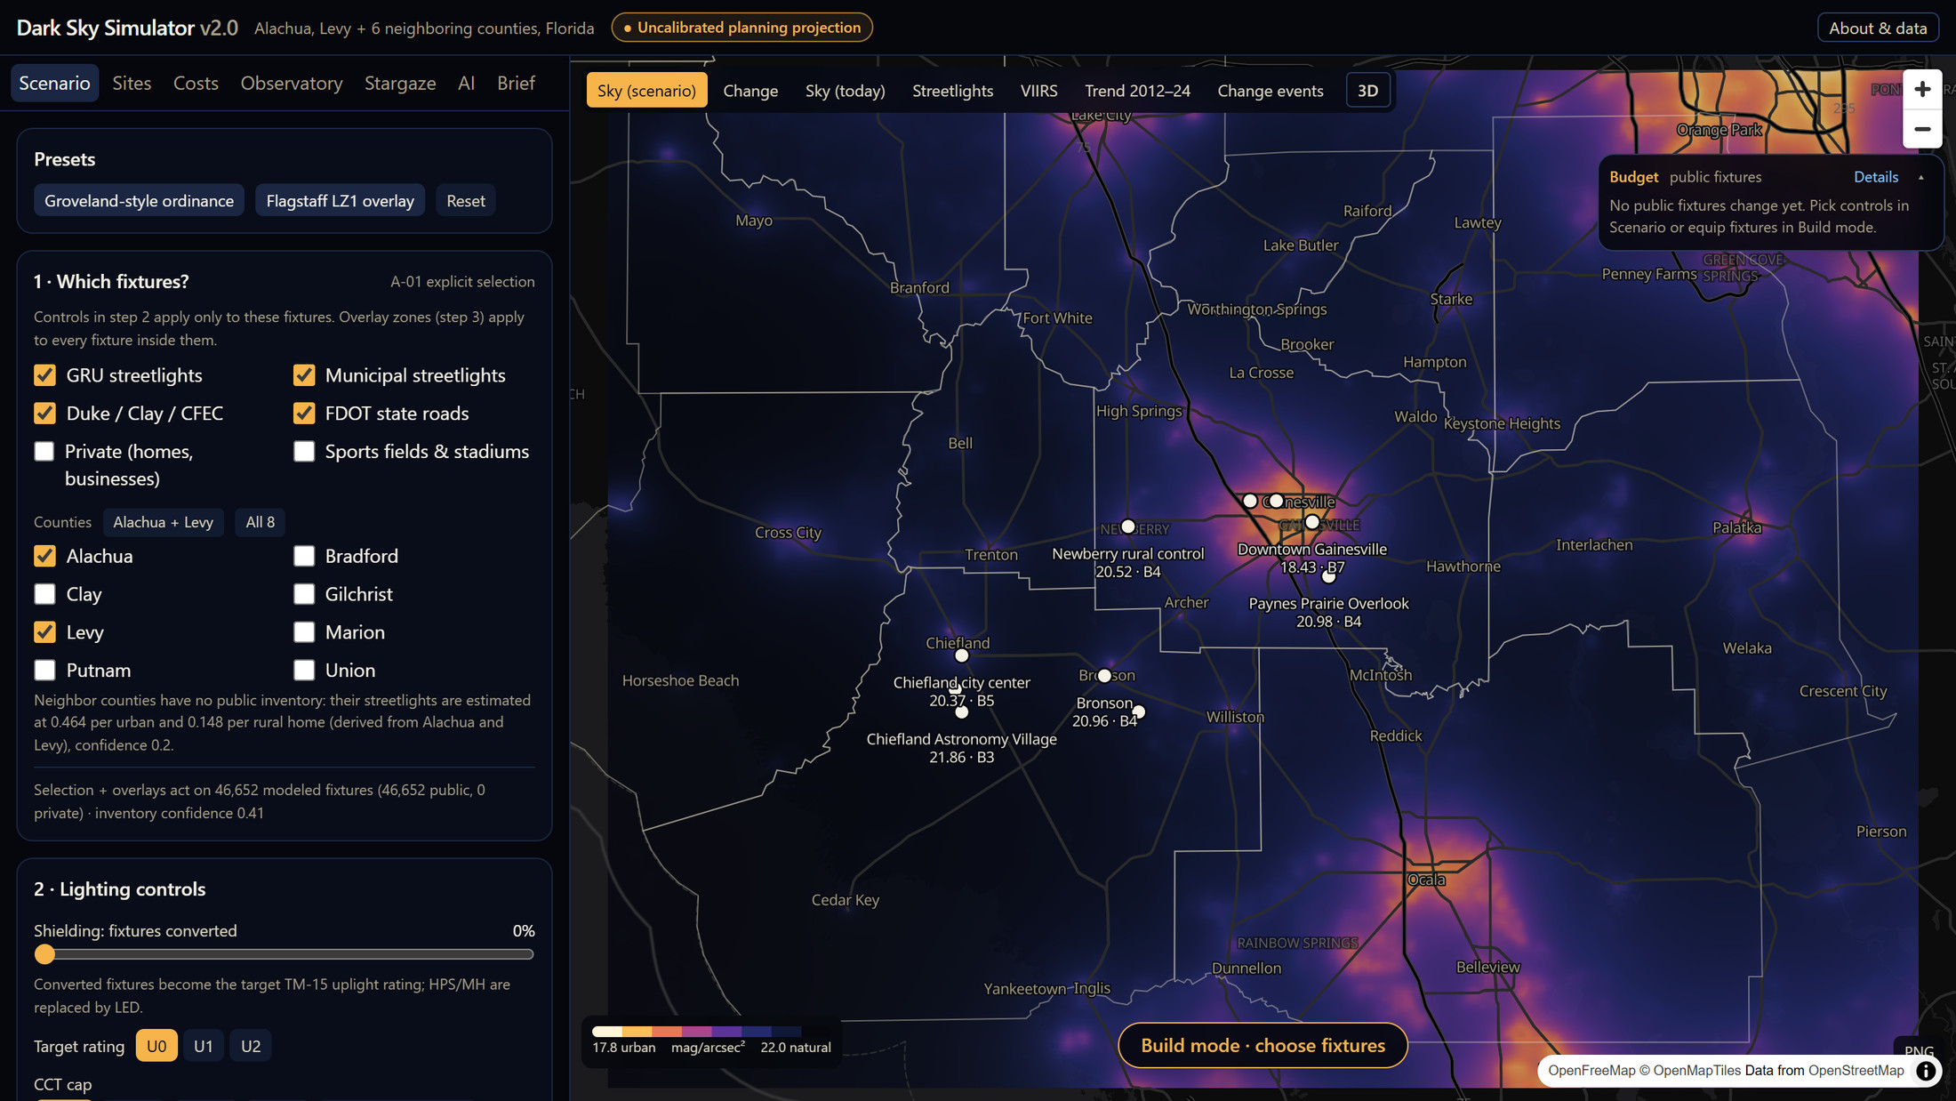
WHY A VERSION 2
v1 told a story. v2 has to answer “How do you know?”
v1 · 2025
v2 · 2026
Hand-tuned multipliers, built in a month
Persuasive headline numbers (“$1.9M a year saved”) that nobody could audit
Physics for the sky, public data for the lights, AI only where data can teach
Every number labeled a planning projection; runs on a phone, no server
Jay Rosen · Restoring the Milky Way · UF AI Days · October 27, 2026
7
Notes:
[3:40–4:10]
Version one started conversations, but it raised questions. I could show $1.9 million a year in projected savings, but a commissioner could ask, "How did you calculate that?"
That's why version two is different. The sky comes from atmospheric physics, the lighting estimates come from public data, and AI is used where it can learn from the satellite record. They're still projections, but now the assumptions can be inspected.

Slide 8
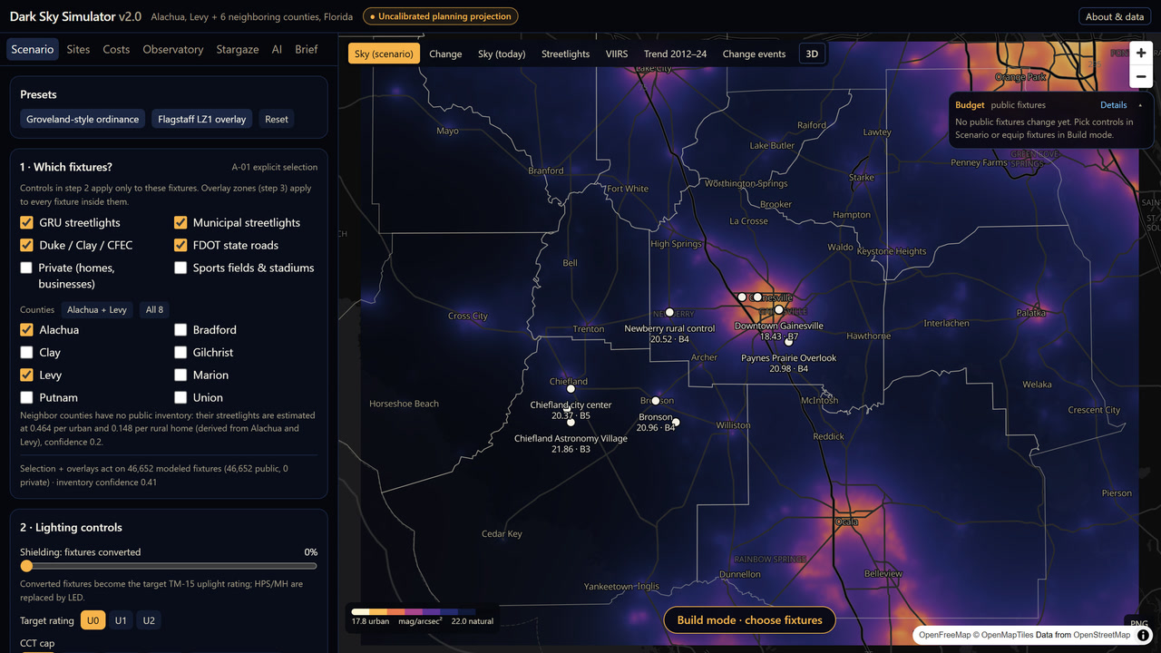
THE SIMULATOR
v2 at a glance
8 counties: Alachua, Levy and six neighbors, ~0.4 km cells
~817,000 modeled light sources: streetlights, homes and businesses, sports fields
Map: modeled zenith sky brightness (mag/arcsec²); yellow = urban, black = near natural
Seven tabs: Scenario · Sites · Costs · Observatory · Stargaze · AI · Brief
Scenario tab with today's modeled sky. Amber badge on every screen: “Uncalibrated planning projection”.
Jay Rosen · Restoring the Milky Way · UF AI Days · October 27, 2026
8
Notes:
[4:10–4:44]
Here's version two. It covers Alachua, Levy and six neighboring counties: about 817,000 modeled light sources, including streetlights, homes, businesses, and sports fields.
The map shows modeled sky brightness: yellow is an urban sky, black is close to natural. You choose lighting standards or areas, and compare what happens to the sky alongside the estimated costs and savings. The heavy physics runs offline, so each scenario updates in a fraction of a second, even on a phone.

Slide 9





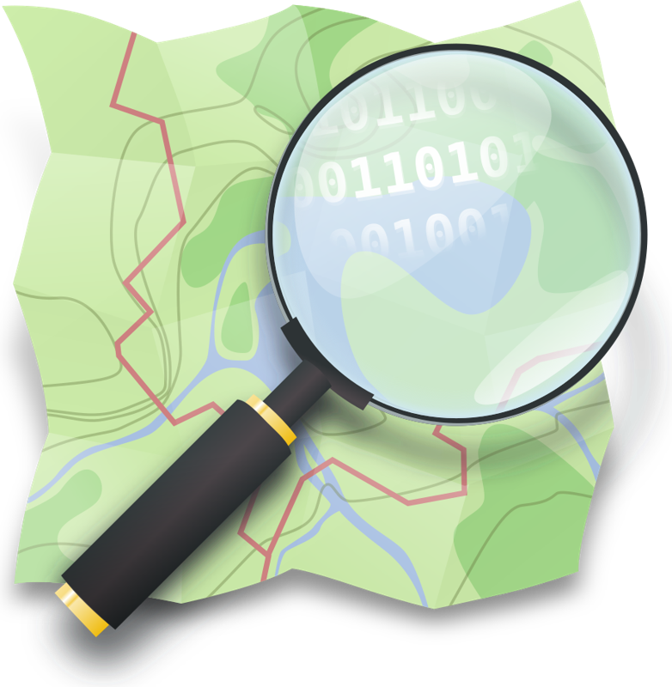












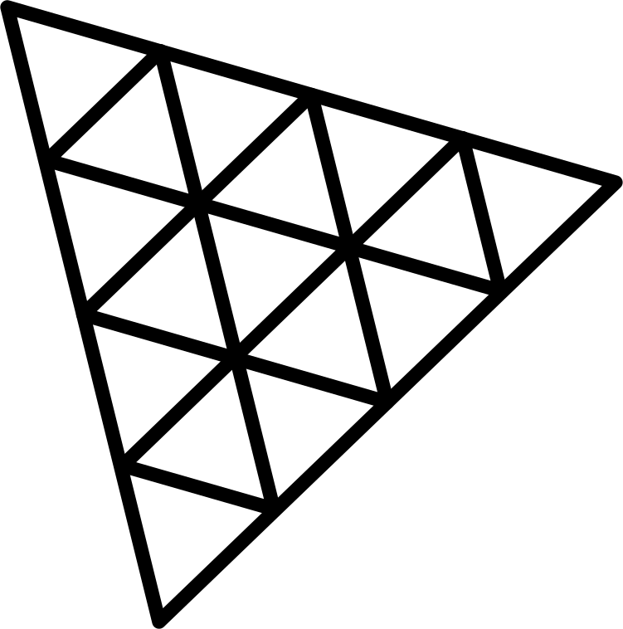



HOW IT'S BUILT
The technology stack
Data
NASA
Black Marble
NOAA
VIIRS night lights
USGS
elevation, land cover
U.S. Census
housing, roads
FEMA
flood zones
OpenStreetMap
roads, lit streets
Alachua County
GIS, Policy 5.3.7
Compute and ML
Google Earth Engine
satellite processing
Google Cloud
compute and scaling
Python
physics pipeline
LightGBM
growth forecast
AI research and coding
Gemini
Deep Research
Gemini Notebook
organizing research
Lovable (v1)
AI app builder
Claude Code (v2)
AI coding
App and hosting
React
web app
TypeScript
app code
MapLibre
maps
Three.js
3D streets
Vite
build
GitHub
code and tests
Vercel
hosting
Jay Rosen · Restoring the Milky Way · UF AI Days · October 27, 2026
9
Notes:
[4:44–5:33]
Here's what it's built with. The data comes from NASA and NOAA satellites, the USGS, the Census Bureau, FEMA, OpenStreetMap, and Alachua County.
Google Earth Engine processes thirteen years of satellite images, and Google Cloud provides compute; it's likely where this scales up. A Python pipeline runs the physics, and LightGBM is the machine-learning model.
For the research, I used Gemini Deep Research to dig in and Gemini Notebook to organize it and understand the more complex findings. I built version one with Lovable and version two with Claude Code. The app runs in the browser with React, MapLibre maps and Three.js for 3D; the code is on GitHub, and it's hosted on Vercel.

Slide 10
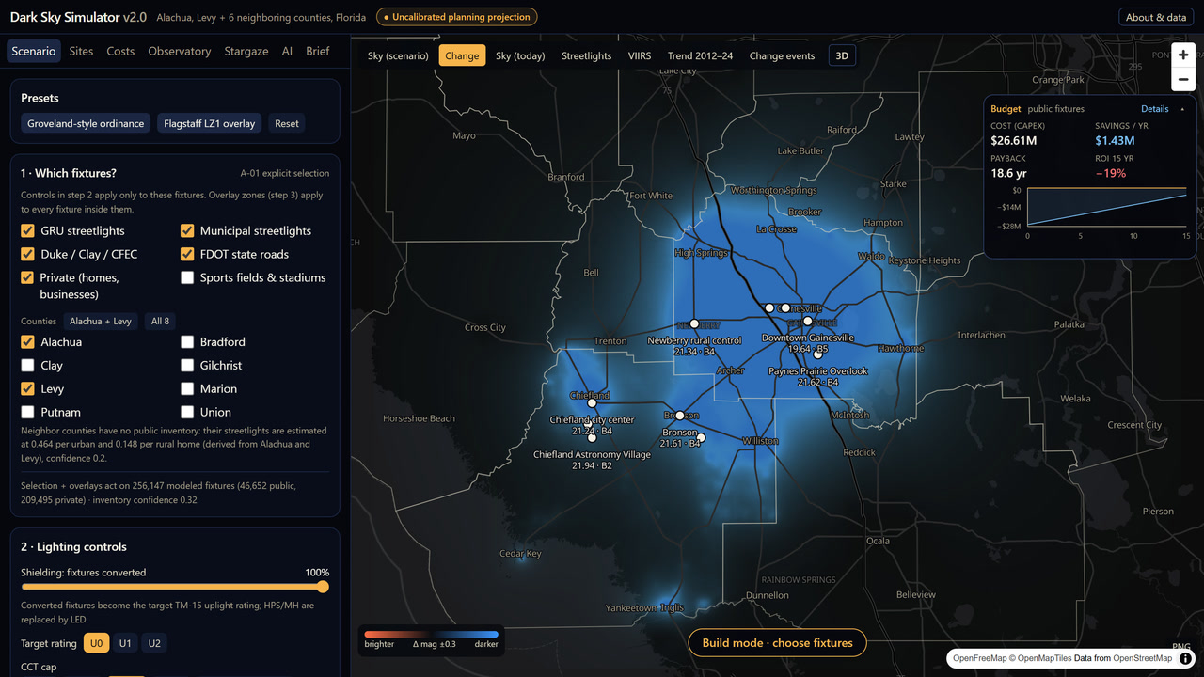
SCENARIO
One click: a Groveland-style ordinance
Groveland: Florida's first dark-sky city
Full shielding (U0), 3000 K cap, dim to 50% from 22:00 to 06:30
Paynes Prairie: 20.98 → 21.62 mag/arcsec² if every light complies; 21.30 with public lights alone
Blue = darker sky, and it crosses county lines
Public cost: $26.6M, $1.43M/yr saved, 18.6-yr payback
Change layer: where the sky gets darker (blue) under the ordinance; Budget card at top right.
Jay Rosen · Restoring the Milky Way · UF AI Days · October 27, 2026
10
Notes:
[5:33–6:08]
Here's a scenario inspired by Groveland, Florida's first dark-sky city: shielding, a 3,000-kelvin limit, and late-night dimming.
Blue shows where the sky gets darker, including across county boundaries. If every public and private light complied, Paynes Prairie would improve from 20.98 to 21.62 magnitudes per square arcsecond in the model, and downtown would move one Bortle class, from 7 to 6. Public lights alone get about half of that. It's a projection, but now we can compare specific policies.

Slide 11
SCENARIO · COSTS
What each government pays, and saves
Right-sized public streetlights: fully shielded 3000 K LEDs at 30% lower output, no smart controllers. Savings = energy + avoided maintenance, at each utility's rates.
Alachua County
University of Florida*
all public streetlights (43,517)
4,100 campus pole lights
$15.3M
$2.55M
6.0 yr
+$23.0M
$984K
$198K
5.0 yr
+$2.0M
one-time cost
saved / year
payback
after 15 years
one-time cost
saved / year
payback
after 15 years
City of Gainesville
State roads (FDOT), Alachua
GRU streetlights (30,000)
1,500 state-road lights
$7.20M
$1.45M
5.0 yr
+$14.6M
$900K
$113K
8.0 yr
+$795K
one-time cost
saved / year
payback
after 15 years
one-time cost
saved / year
payback
after 15 years
Levy County
City of Chiefland
all public streetlights (3,135)
285 city streetlights
$1.88M
$228K
8.3 yr
+$1.54M
$171K
$21.5K
8.0 yr
+$152K
one-time cost
saved / year
payback
after 15 years
one-time cost
saved / year
payback
after 15 years
*UF: 4,100 campus pole lights, about 60% already LED (UF News, 2023), run through the simulator's cost engine at GRU rates. Gainesville and FDOT are within Alachua's total.
Jay Rosen · Restoring the Milky Way · UF AI Days · October 27, 2026
11
Notes:
[6:08–6:42]
Policy also means budgets. This is a simpler retrofit: warmer, shielded LEDs at 30 percent lower output, without smart controllers on every pole.
For all of Alachua County's public streetlights, the estimate is $15.3 million up front, saving about $2.55 million a year: about a six-year payback. Gainesville's GRU lights and the state roads are part of that total. Levy County and Chiefland pay back in about eight years.
These projections still need real inventories and rates.

Slide 12
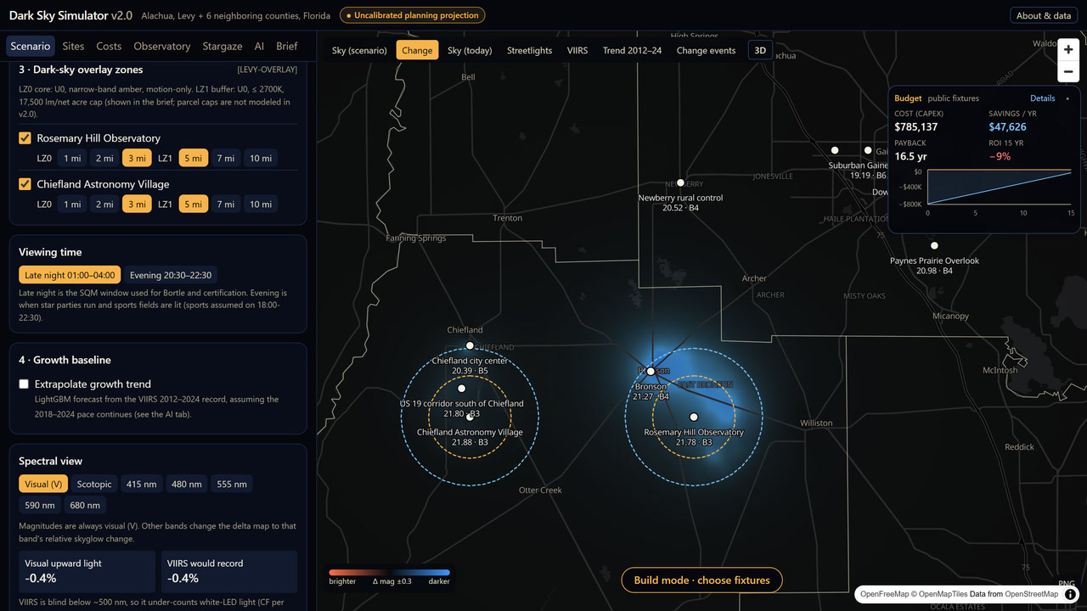
SCENARIO
Or protect just the observatories
Overlay zones: stricter rules in rings around Rosemary Hill and Chiefland Astronomy Village
LZ0 core: shielded, amber, motion-only
LZ1 buffer: shielded, ≤ 2700 K
Flagstaff-style preset: about $0.79M in public retrofits
A trade-off a commission can actually vote on
Flagstaff LZ1 overlay preset (3-mile core, 5-mile buffer) on the Change layer.
Jay Rosen · Restoring the Milky Way · UF AI Days · October 27, 2026
12
Notes:
[6:42–7:04]
We don't have to change every light. We could focus on astronomy sites.
Here I model stricter zones around Rosemary Hill and Chiefland Astronomy Village: amber, motion-controlled cores and warmer-light buffers. That Flagstaff-style approach comes to about $790,000 in projected public retrofits. That gives counties a targeted alternative.

Slide 13
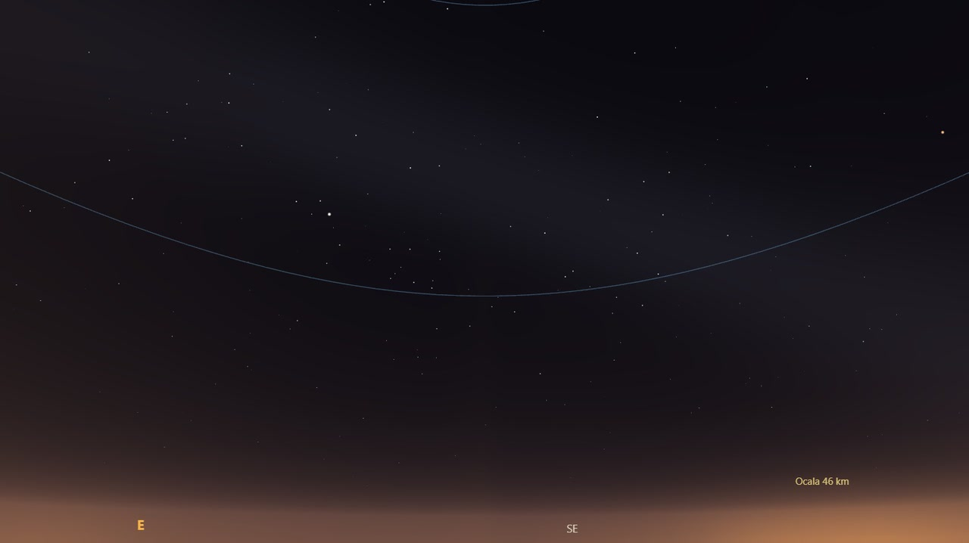
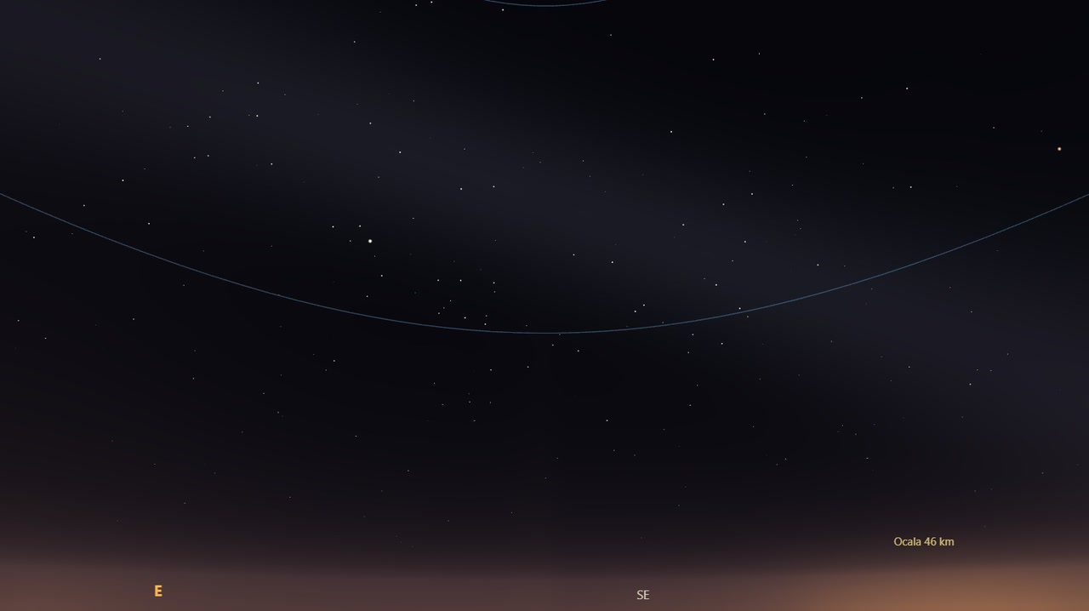
SEE IT
Paynes Prairie, today and with the ordinance
Today
With a Groveland-style ordinance (every light, public and private, complies)
All-sky view from Paynes Prairie Overlook, looking southeast as the Milky Way rises: May 28, 2022, from 1:30 AM, no Moon. Illustrative, not a photograph.
20.98 mag/arcsec² · Bortle 4
Faintest naked-eye stars ≈ magnitude 6.1
21.62 mag/arcsec² (+0.64) · still Bortle 4
Faintest stars ≈ 6.4: a clearer Milky Way
Jay Rosen · Restoring the Milky Way · UF AI Days · October 27, 2026
13
Notes:
[7:04–7:32]
Numbers like 20.98 and 21.62 don't tell most people what they'll see. So the simulator also draws the sky: Paynes Prairie looking southeast as the Milky Way rises, like my title photo.
Under the ordinance, the horizon glow fades and fainter stars appear. It's still Bortle 4, but the Milky Way is clearer. This is a visualization of the model, not a before-and-after photograph.

Slide 14
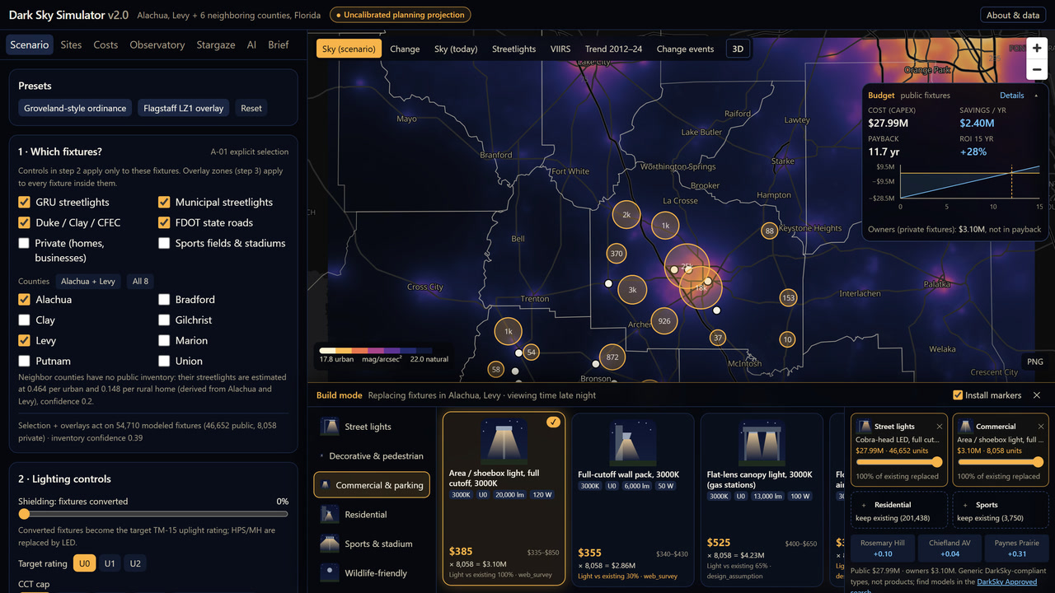
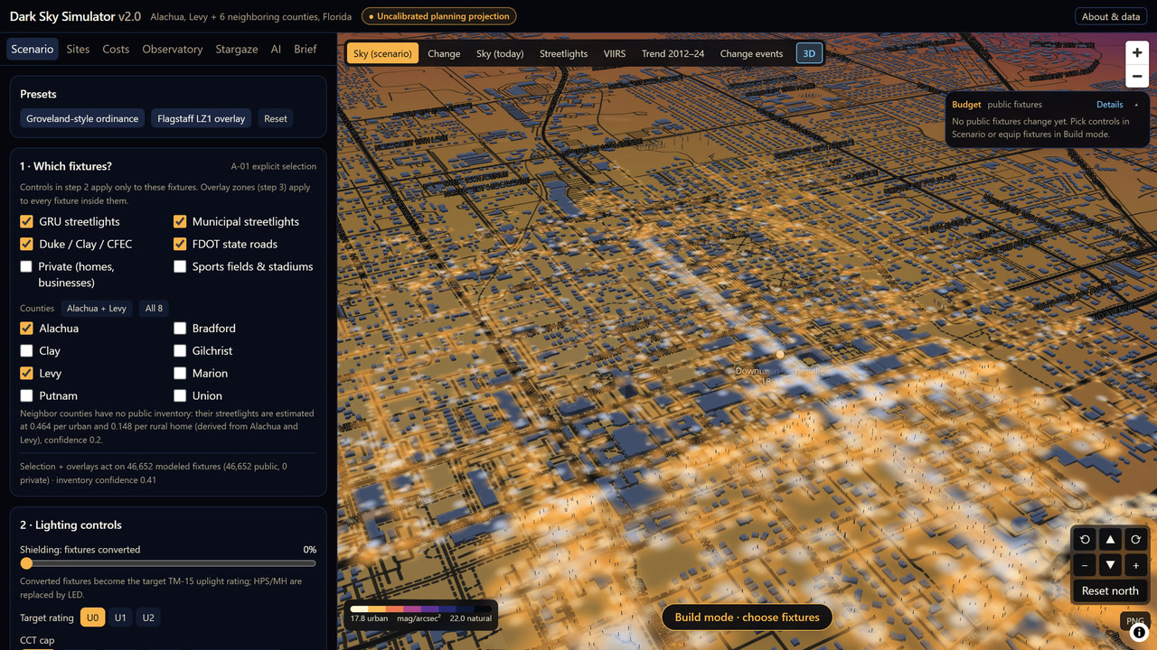
SCENARIO
Build mode and 3D: toward a digital twin
Build mode
3D: downtown Gainesville
Catalog of 17 DarkSky-compliant fixture types: spectrum, uplight rating, watts, installed cost
Equip one: sky, budget, brief and install markers update
Terrain, buildings and every modeled light at street level
Mapped streetlights where they stand; modeled ones along the roads of their cell
The goal: a digital twin of the illumination and darkness of Gainesville and North Central Florida
Jay Rosen · Restoring the Milky Way · UF AI Days · October 27, 2026
14
Notes:
[7:32–8:05]
You can also go from regional policy to individual lights. Build mode has seventeen types of dark-sky-compliant fixtures, each with specifications and installed cost estimates. Change one and the map and costs update.
This 3D view is downtown Gainesville, with modeled lights along its streets. My goal is to grow this into a digital twin of the illumination and darkness of Gainesville and North Central Florida: every light, and the night sky it leaves.

Slide 15
THE AI · 1
Where AI is used, and where it isn't
1 · Data
NASA Black Marble
13 years, 2012–2024
2 · Cleaning
remove the
solar-cycle airglow
3 · Statistics
step test on every
lit cell → change events
4 · Machine learning
LightGBM forecast
of where light grows
→ change-events map
→ 2034 sky and observatory site ranking
NOT AI: physics and explicit rules you can inspect
Sky brightness: atmospheric scattering physics
Scenario effects: published fixture rules
Site ranking: weighted sum, weights you set
Costs: unit prices × fixture counts
Jay Rosen · Restoring the Milky Way · UF AI Days · October 27, 2026
15
Notes:
[8:05–8:33]
Since this is AI Days, I want to be precise about where AI fits in. The skyglow simulation itself is physics, and the cost calculations are explicit rules. Neither one is a neural network.
The satellite analysis has two parts: a statistical test for sudden changes in light, and a trained LightGBM model that estimates where growth might concentrate. That distinction matters for trust.

Slide 16
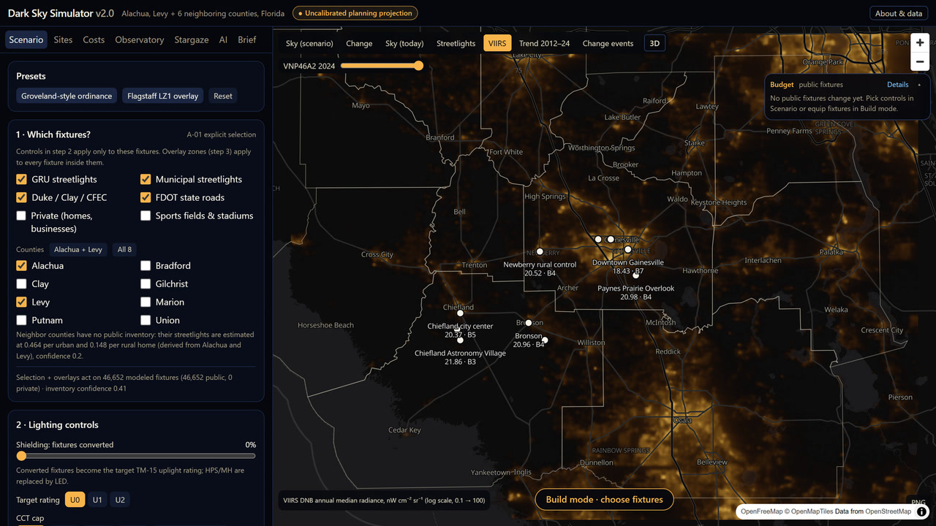
THE AI · 2
The data: 13 years of NASA night lights
NASA Black Marble (VIIRS VNP46A2): nightly, moonlight- and angle-corrected, ~500 m
Keep cloud-free, high-quality nights; one median per year per cell, 2012–2024
Pulled through Google Earth Engine's free noncommercial tier in ~12 minutes
The 2024 layer also tells the physics model where private lighting is
VIIRS layer: yearly median radiance with the airglow background removed; the slider steps through 2012–2024.
Jay Rosen · Restoring the Milky Way · UF AI Days · October 27, 2026
16
Notes:
[8:33–9:08]
The foundation is thirteen years of NASA satellite observations, 2012 through 2024. That record is where this project started: the first simulator was based on comparing how many pixels were lit up each year, over time.
Version two uses NASA's Black Marble VIIRS data, corrected nighttime radiance at about 500 meters. In Google Earth Engine, I take a median of the cloud-free readings for each year and cell, and you can watch the lights change year by year.

Slide 17
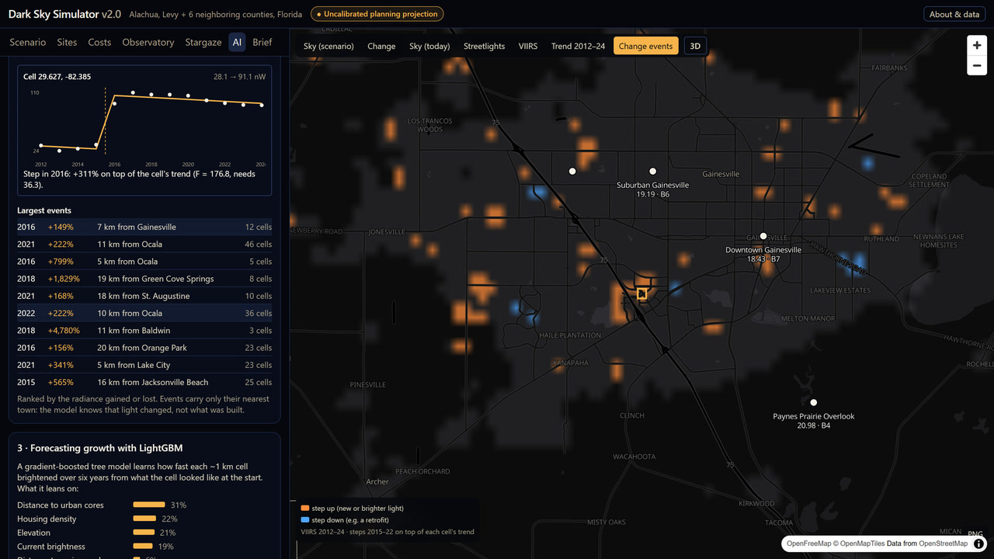
THE AI · 3
What the AI found, and how we checked it
Found on its own: the top-ranked change in light since 2012, a sudden jump near I-75 and Archer Road in 2016
That's Celebration Pointe: Bass Pro Shops opened in November 2016. Nobody told the AI where to look
Cleaned first: the upper atmosphere's natural glow follows the Sun's cycle; we remove it so the AI learns our lights, not the Sun
Checked: graded only on years it never saw; sky model vs 53 real meter readings (about 0.5 mag darker, and we say so)
AI tab: clicking the top event flies the map to it and shows the cell's 13 years with the jump.
Jay Rosen · Restoring the Milky Way · UF AI Days · October 27, 2026
17
Notes:
[9:08–10:12]
Here's what the AI found on its own. It looked at the thirteen-year history of every lit spot, nearly 29,000 of them, and asked one question: did the light change gradually, or jump suddenly in one year? The top event, the most light gained, was a sudden jump near I-75 and Archer Road in 2016. That's Celebration Pointe, where Bass Pro Shops opened that November. Nobody told it where to look.
Two things make that trustworthy. We cleaned the data first: the upper atmosphere glows on its own, rising and falling with the Sun's cycle, so we subtract that glow; otherwise the AI would learn the Sun, not our lights. And we check its work: the forecast is graded only on years it never saw, and the sky model is compared with 53 real sky-meter readings. It reads about half a magnitude darker than they do, and we publish that.

Slide 18
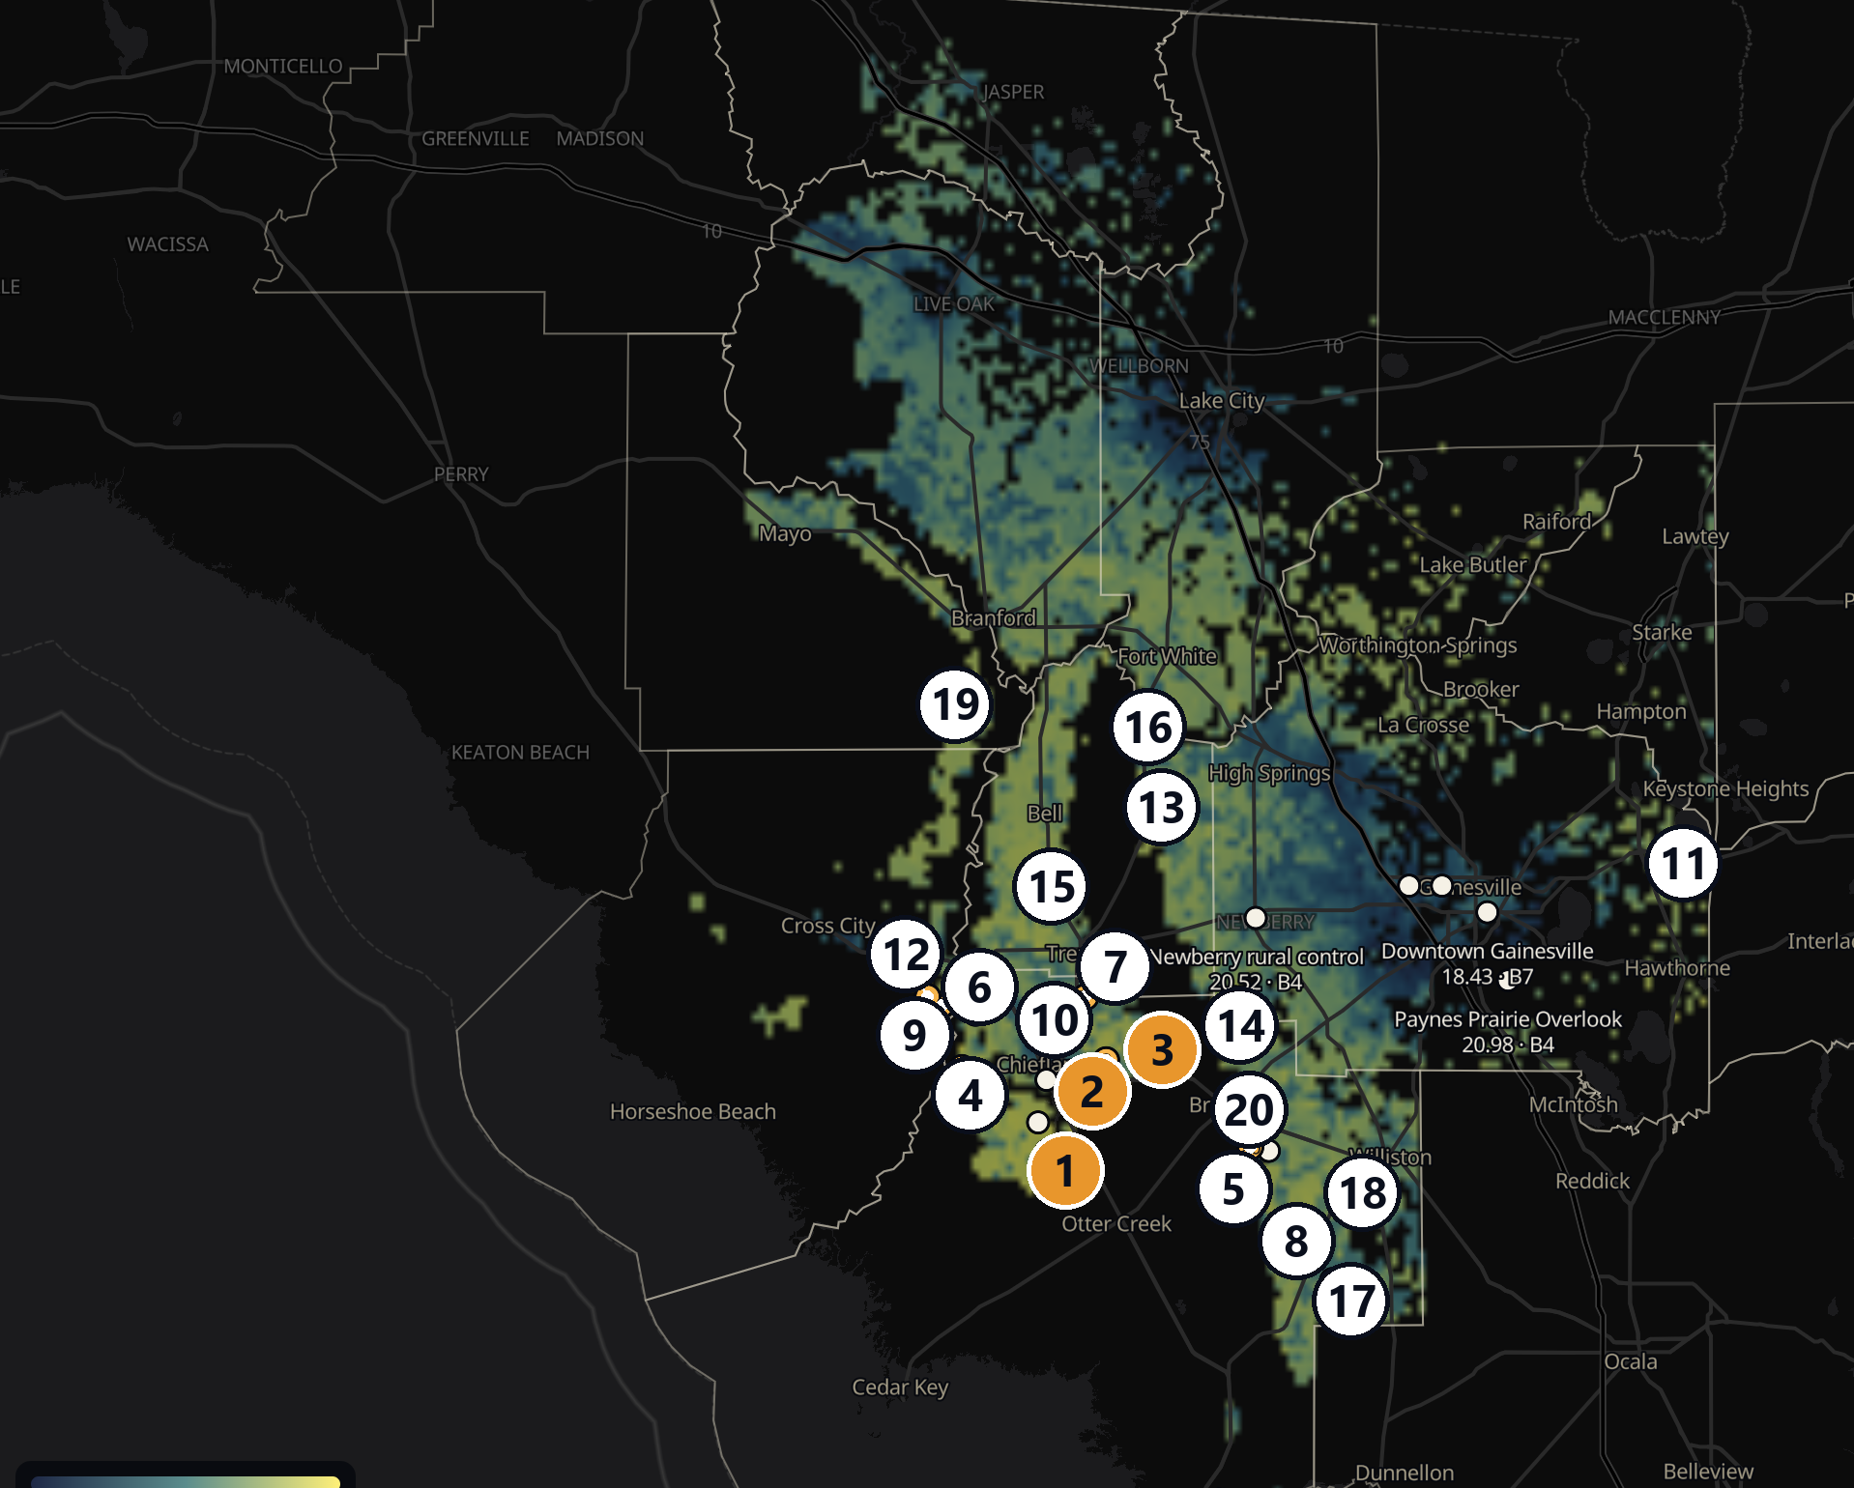
IN USE
Where could UF build its next observatory?
Requested by Dr. Elizabeth Lada, Chair of UF Astronomy
Every ~1 km cell of 11 counties scored: dark sky today and in 2034 (LightGBM), clear air, land, access, drive time from UF
Ruled out: water and wetland, the coast, ground below 5 m (storm surge), 2080 flood projections, FEMA's 100-year floodplain, over ~90 min away
Shortlist: Levy #1–#3, between Chiefland and Bronson: 44–58 min from campus, Bortle 3, land $605K–806K for 80 acres
Telescope + building: $1–3M in published examples → ≈ $1.6–3.8M total
Observatory tab: the top 20 sites by rank (orange = Levy shortlist; markers enlarged). Blank areas are ruled out: water, wetland, flood-prone ground or over 90 minutes away.
Jay Rosen · Restoring the Milky Way · UF AI Days · October 27, 2026
18
Notes:
[10:12–10:45]
That brings me back to Dr. Lada's observatory question. The tool screens eleven counties using current sky, 2034 growth scenarios, land, access, and travel time.
It excludes places like wetlands, flood-prone land, and areas too far away. The current shortlist points to three Levy County locations between Chiefland and Bronson, about forty-five minutes to an hour from UF, with roughly $600,000 to $800,000 estimated for eighty acres. It's preliminary screening, not a parcel-level site study.

Slide 19
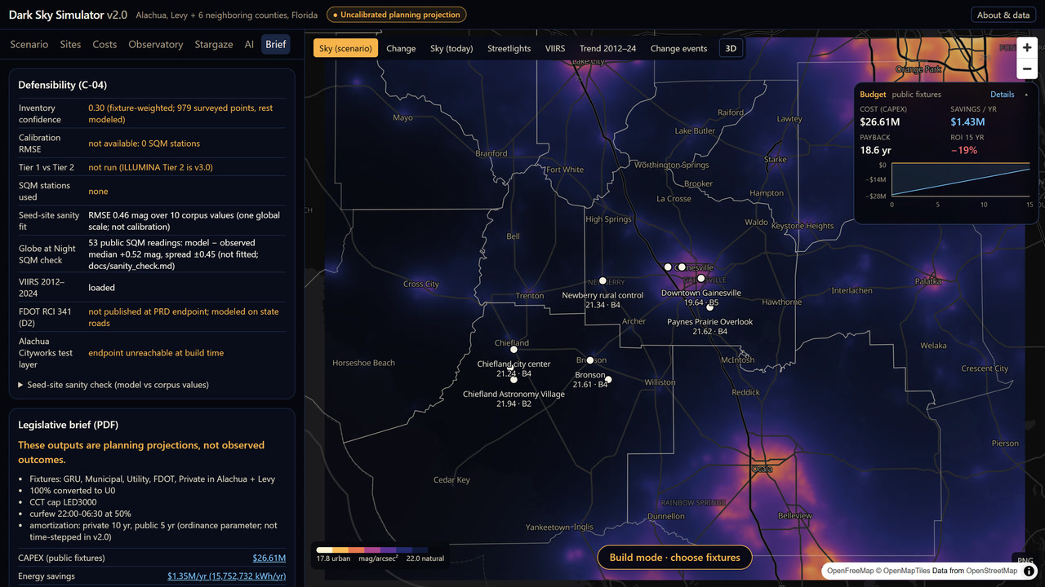
IN USE
From model to policy brief
One-click PDF for commissioners; every figure links back to its scenario
First line: “These outputs are planning projections, not observed outcomes.”
Defensibility panel lists what's missing: sky-meter stations, utility inventories, satellite calibration
That list is the v3 plan
Brief tab: defensibility panel and the legislative brief.
Jay Rosen · Restoring the Milky Way · UF AI Days · October 27, 2026
19
Notes:
[10:45–11:10]
Decision-makers shouldn't have to read the source code. The Brief tab produces a PDF that explains the selected scenario, its projected impact, and its costs.
It opens with a statement that these are planning projections, not observed results, and it lists the missing evidence, like sky measurements and verified streetlight inventories. The caveats travel with the numbers.

Slide 20
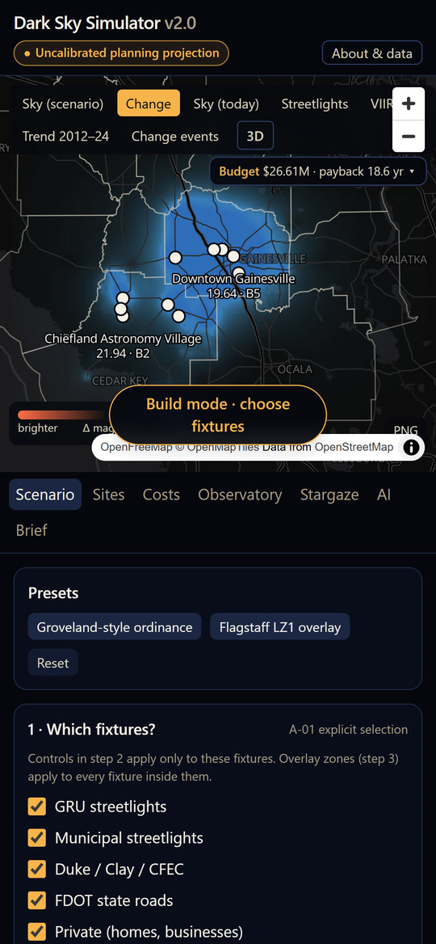
WHAT'S NEXT
Scaling up: from projection to evidence
Ground truth: sky-quality meters in every county + a 50-node low-cost sensor pilot (~$5,900 hardware)
Real inventories: utility data-sharing agreements (GRU, Duke, Clay, CFEC)
Computer vision: a YOLO detector on street-level imagery to classify fixtures
Retrofit detection: monthly satellite data; fit the LED correction on GRU's 3000 K conversions
Scaling: a reusable county package (satellite data, lighting, development, policy), Levy County next
Siting: parcel-level flood maps and site visits; blind test with UF Astronomy
Looking for collaborators in sensors, computer vision, remote sensing and policy
The same app on a phone
Jay Rosen · Restoring the Milky Way · UF AI Days · October 27, 2026
20
Notes:
[11:10–11:34]
Next we need ground truth: sky-quality meters and low-cost sensors, real utility inventories, computer vision to classify fixtures, and monthly satellite data.
The simulator is built around reusable county data packages, so Levy County is next without rebuilding the engine. If you work on sensors, computer vision, remote sensing, or policy, let's talk.

Slide 21
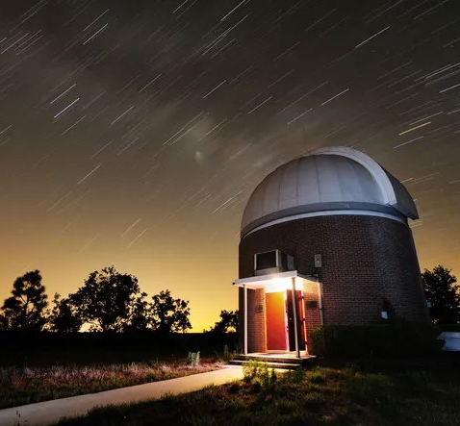
WHAT'S NEXT
What UF can do
Alachua County has adopted dark-sky principles; UF plans its own campus, coordinated with the county, so it can lead
Lead on campus: the model projects about $984K to upgrade UF's 4,100 pole lights, saving about $198K a year
Protect UF's skies: keep Rosemary Hill dark and choose a site for UF Astronomy's next observatory
Measure the real sky: a 50-sensor network (about $6,000 in hardware) to check the model against real readings
Independent and unfunded so far: I'd like this to become a UF project
UF's Rosemary Hill Observatory. Photo: The Gainesville Sun, April 2012.
Jay Rosen · Restoring the Milky Way · UF AI Days · October 27, 2026
21
Notes:
[11:34–12:18]
I want to finish with something UF could actually do. The county has adopted dark-sky principles, and UF could lead alongside it on campus.
For UF's roughly 4,100 pole lights, the model projects about $984,000 to retrofit and $198,000 a year in savings, pending a verified inventory and rates.
UF could also help establish ground truth: about $6,000 in hardware supports a pilot network of fifty sky-brightness sensors, to validate the model and help protect Rosemary Hill and future observatory sites.
So far, I've developed this independently, without dedicated funding. I'd like to see it become a collaborative UF research project.

Slide 22
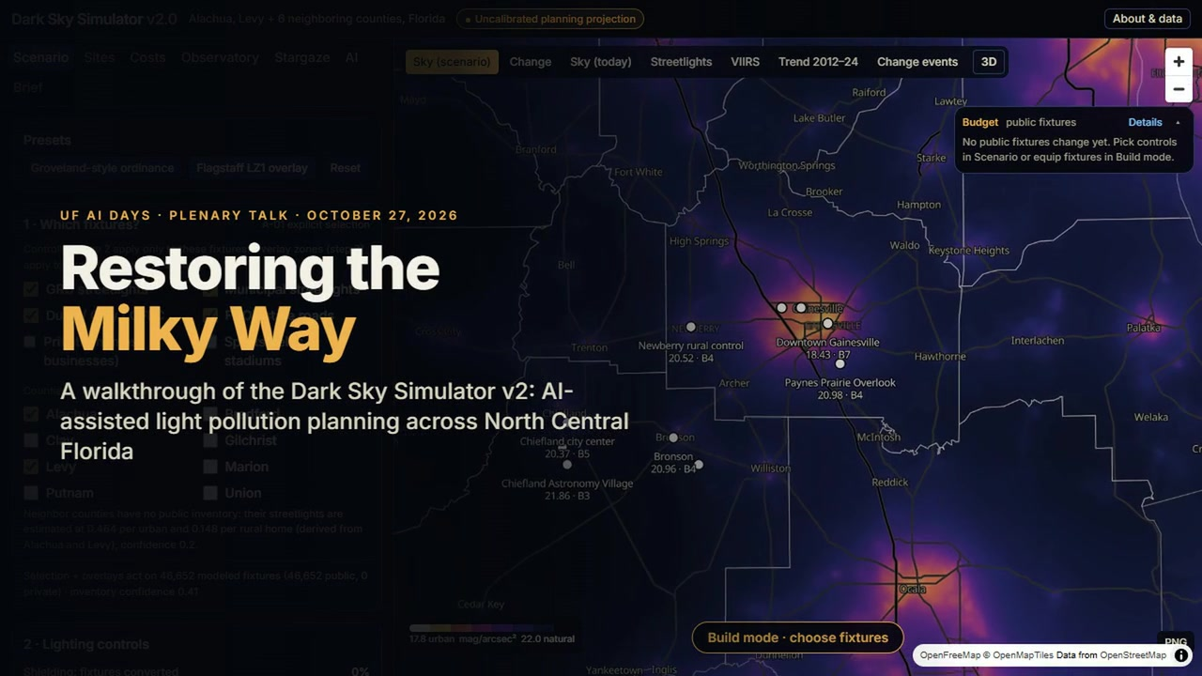


Thank you
Questions?
Try it
Code
dark-sky-simulator-v2.vercel.app/dark-sky
github.com/jayrosen-design/dark-sky-simulator-v2
Jay Rosen · jayrosen@ufl.edu
Notes:
[12:18–12:35]
The first QR code opens the live simulator. The second links to the source and methods on GitHub.
Thank you. I'd be happy to talk about the science, the local policy work, or ways to collaborate.
[The 70-second supercut loops on this slide during questions. Prepared answers are on the hidden backup slides.]

Slide 23
SOURCES
References
ABC7 Los Angeles (c. 2011). Domes put in place for CSUSB's observatory.
Alachua County (2026, February 13). Comprehensive Plan proposed evaluation and appraisal based amendments, Conservation and Open Space Element, Policy 5.3.7.
Andrews, D. W. K. (1993). Tests for parameter instability and structural change with unknown change point. Econometrica, 61(4), 821–856.
Bortle, J. E. (2001). Introducing the Bortle dark-sky scale. Sky & Telescope, 101(2), 126–129.
Cangialosi, J. P., & Alaka, L. (2026). Tropical Cyclone Report: Hurricane Idalia (AL102023), 26–31 August 2023. National Hurricane Center (original report February 13, 2024).
City of Groveland, Florida (2022). Ordinance 2022-26, outdoor lighting regulations.
Dark Sky Simulator fixture catalog (2026): installed unit costs from the research reports and a retail price survey of DarkSky-compliant fixture types (September 26, 2026); DarkSky Approved luminaire search, darksky.org.
Dark Sky Simulator research reports (2025): Gainesville Dark Sky Lighting Assessment; Streetlight Retrofit Cost-Benefit Analysis (Levy); Smart Streetlight Cost-Benefit Analysis; Street Lighting Dimming Savings Calculation (Duke LS-1, Clay Schedule L, CFEC). Unpublished.
DarkSky International & Illuminating Engineering Society (2020). Five Principles for Responsible Outdoor Lighting. darksky.org.
DarkSky International. DarkSky Approved program and seal. darksky.org/what-we-do/darksky-approved.
DarkSky International. International Dark Sky Places program guidelines (Dark Sky Park: sky ≥ 21.2 mag/arcsec²). darksky.org.
Dewitz, J. (2023). National Land Cover Database (NLCD) 2021 Products. U.S. Geological Survey data release. doi:10.5066/P9JZ7AO3.
Elvidge, C. D., Zhizhin, M., Ghosh, T., Hsu, F.-C., & Taneja, J. (2021). Annual time series of global VIIRS nighttime lights derived from monthly averages: 2012 to 2019. Remote Sensing, 13(5), 922.
EMJ Construction (2016, September 1). Two new Florida Bass Pro locations underway. emjcorp.com.
Falchi, F., Cinzano, P., Duriscoe, D., et al. (2016). The new world atlas of artificial night sky brightness. Science Advances, 2(6), e1600377.
Federal Emergency Management Agency (2026). National Flood Hazard Layer (NFHL): Special Flood Hazard Areas. hazards.fema.gov, accessed October 20, 2026.
Florida Department of Revenue (2025). Tax roll and qualified sales (parcels ≥ 5 acres), via the Florida Geographic Information Office statewide parcels.
Florida Institute of Technology (2004, August 19). Funding secured for Florida Tech telescope. Florida Tech News.
Garstang, R. H. (1986). Model for artificial night-sky illumination. Publications of the Astronomical Society of the Pacific, 98, 364–375.
Gorelick, N., Hancher, M., Dixon, M., et al. (2017). Google Earth Engine: Planetary-scale geospatial analysis for everyone. Remote Sensing of Environment, 202, 18–27.
Ke, G., Meng, Q., Finley, T., et al. (2017). LightGBM: A highly efficient gradient boosting decision tree. Advances in Neural Information Processing Systems, 30, 3146–3154.
Krisciunas, K., & Schaefer, B. E. (1991). A model of the brightness of moonlight. Publications of the Astronomical Society of the Pacific, 103, 1033–1039.
Kyba, C. C. M., Altıntaş, Y. Ö., Walker, C. E., & Newhouse, M. (2023). Citizen scientists report global rapid reductions in the visibility of stars from 2011 to 2022. Science, 379(6629), 265–268.
OpenStreetMap contributors (2026). Road, street-lamp and sports-venue data. openstreetmap.org (ODbL).
Roldán Hernández, C. (2023, January 17). Security enhancements make for a brighter, safer campus. UF News, University of Florida.
Román, M. O., Wang, Z., Sun, Q., et al. (2018). NASA's Black Marble nighttime lights product suite. Remote Sensing of Environment, 210, 113–143.
Rosen, J. (2025). Dark Sky Simulator (v1) [software]. Zenodo. doi:10.5281/zenodo.17252185.
Rosen, J. (2026). Dark Sky Simulator v2 [software], incl. ADR 0013 (the 19% reconstruction). github.com/jayrosen-design/dark-sky-simulator-v2.
Rosen, J. (2026, January 13). Preserving natural skies in Alachua County: Light pollution mitigation and economic impact. Alachua County Environmental Protection Advisory Committee.
Smith, J. (2026, March 24). Restoring the Milky Way: Arts alumnus develops app to reduce light pollution. UF College of the Arts.
Sweet, W. V., et al. (2022). Global and Regional Sea Level Rise Scenarios for the United States. NOAA Technical Report NOS 01. National Oceanic and Atmospheric Administration.
The Gainesville Sun (2012, April). Photograph of the University of Florida Rosemary Hill Observatory.
U.S. Census Bureau (2020). TIGER/Line boundaries and roads; 2020 Census housing-unit counts.
U.S. Energy Information Administration (2023). How much electricity does an American home use? FAQ (2022 average: 10,791 kWh per residential customer). eia.gov.
Ward, P. J., et al. (2020). Aqueduct Floods Methodology. Technical Note. World Resources Institute. Data: WRI Aqueduct Floods Hazard Maps V2 via Google Earth Engine.
York University (2019, August 16). Installation of new telescope expected to be largest at a Canadian university. YFile.
Jay Rosen · Restoring the Milky Way · UF AI Days · October 27, 2026
23
Notes:
[Hidden. To show it during the slide show, type 23 and press Enter.]
These are the sources behind the talk and the poster, in alphabetical order; the poster numbers them in the order cited.
If someone asks where a piece comes from: the sky physics is Garstang's 1986 skyglow model. The satellite record is the annual VIIRS night-lights series from Elvidge and colleagues, pulled through Google Earth Engine. The step test is a test for a break at an unknown year, after Andrews, 1993. The forecast uses LightGBM, from Ke and colleagues, 2017. The sky classes are Bortle's 2001 scale, the preset is Groveland's 2022 ordinance, and the policy is Alachua County's Policy 5.3.7 amendment.
Every source is also linked from the GitHub repository on the closing slide.

Slide 24
BACKUP · HOW IT WORKS
Heavy work offline, instant scenarios in the browser
Public data
Offline pipeline · Python
Static data package
Browser · React + MapLibre
NASA VIIRS night lights
(Google Earth Engine)
Census · OpenStreetMap
streetlight inventories
parcels · elevation
Globe at Night meters
Atmospheric scattering
kernels (Garstang)
place every fixture
AI: change detector
+ LightGBM forecast
16-bit grids + JSON
one layer per
fixture group × county
(basis layers)
sky = weighted sum
of basis layers
~55 ms per scenario
map · 3D · charts · PDF
Skyglow adds linearly, so any ordinance is a re-weighting of precomputed layers: a phone can explore it instantly
The sky is a published single-scattering model (Garstang 1986), not a neural network
Jay Rosen · Restoring the Milky Way · UF AI Days · October 27, 2026
24
Notes:
[Backup, cut from the talk for time. To show it, type 24 and press Enter during the slide show.]
The architecture is what makes it fast. Everything heavy runs once, offline, in Python: scattering integrals for the atmosphere, placing every fixture, processing the satellite record, and training the models.
The output is a static data package with one precomputed layer per group of fixtures.
Because skyglow adds up linearly, the browser only has to compute a weighted sum of those layers for any scenario, about 55 milliseconds, so a phone can explore any ordinance instantly.
And to be clear: the sky itself comes from a published single-scattering physics model, not a neural network.

Slide 25
BACKUP · AI
Lesson 1: check the data before the model
First pull came back 10× too dark: a scale factor applied twice
Then forests and wetlands “brightened” 70–120% from 2020 to 2023
Cause: airglow, upper-atmosphere light that follows the 11-year solar cycle
Fix: subtract each year's background, the median of the darkest fifth of the region, before any model sees the data
Background glow over unlit land, nW cm⁻² sr⁻¹
Solar minimum 2019–20: 0.10 · rising solar activity 2023: 0.33
Jay Rosen · Restoring the Milky Way · UF AI Days · October 27, 2026
25
Notes:
[Backup, cut from the talk for time. To show it, type 25 and press Enter during the slide show.]
Lesson one: the most important AI work in this project was checking the data.
Our first pull came back ten times too dark. Earth Engine had already applied a scale factor, and we applied it again.
Then forests and wetlands appeared to brighten 70 to 120 percent between 2020 and 2023. They didn't. That's airglow: faint light from the upper atmosphere that follows the eleven-year solar cycle. You can see it in the chart: 0.10 nanowatts at the 2020 solar minimum, 0.33 in 2023.
A model trained on that would have learned the Sun, not development. So every year we subtract the background, the median of the darkest fifth of the region, before any model sees the data.

Slide 26
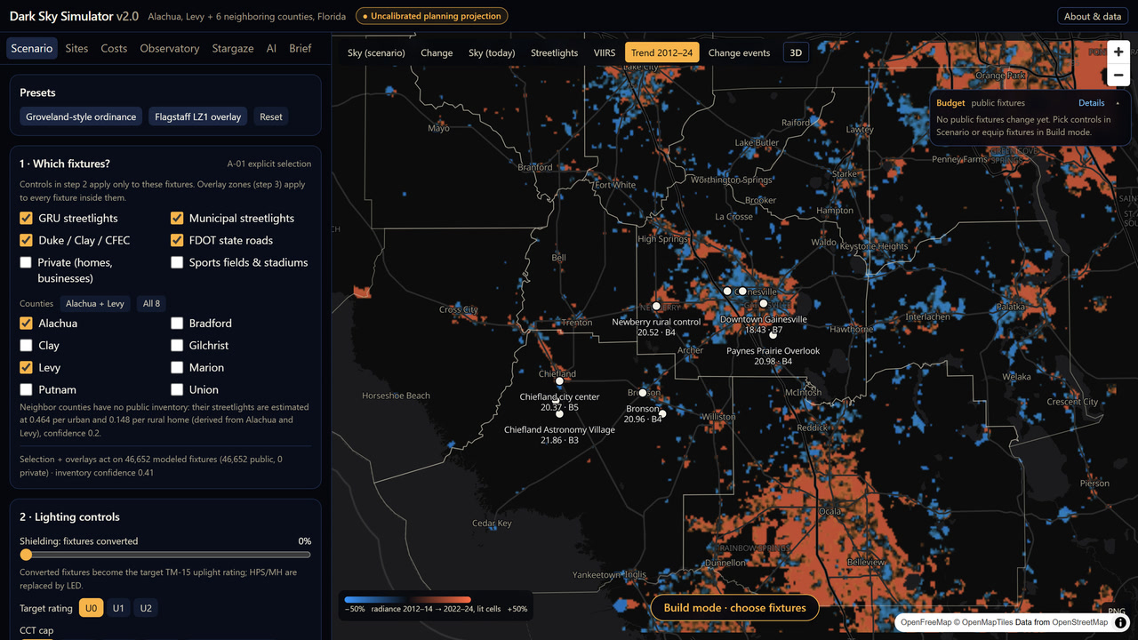
BACKUP · AI
Revisiting the 19% estimate with calibrated satellite data
AI analysis of NOAA night imagery, 2012 → 2024: ≈19% brighter (v1)
Re-measured in calibrated radiance, 2013–24: the region around Alachua County rose ~20% (NOAA) or ~13% (NASA)
Inside the county line: 3–6%; around Gainesville ≈5%. Growth concentrates along I-75 and around Ocala
Calibrated radiance, 2013 → 2024 | NOAA EOG | NASA BM
Region around the county | +20.5% | +12.8%
Alachua County | +6.1% | +2.9%
Gainesville | +5.0% | +4.8%
Trend 2012–24 layer: change from 2012–14 to 2022–24 for lit cells; growth along I-75 and around Ocala.
Jay Rosen · Restoring the Milky Way · UF AI Days · October 27, 2026
26
Notes:
[Backup, cut from the talk for time. To show it, type 26 and press Enter during the slide show.]
Lesson two: recheck your own headline. Version 1 said the area was 19 percent brighter, from comparing two map screenshots of 2012 and 2024.
When I rebuilt that analysis this month, the 19 percent turned out to describe the whole map view, about 212 by 131 kilometers, from Perry to the St. Johns River, not Alachua County.
In calibrated satellite radiance, that region did brighten about 20 percent from 2013 to 2024. The county itself rose 3 to 6 percent, depending on the product, and Gainesville about 5.
The story holds: the region around us is brightening faster than the county. But the number on the slide had to change, and the app now quotes the calibrated figures.
[Details and reproducible code: docs/adr/0013 and analysis/epac_reconstruction in the repository.]

Slide 27
BACKUP · AI
What the detector can't see
A lit cell's yearly values scatter ≈ 10% around its trend
At that noise a +50% step is caught 10% of the time, a −30% step 6%
So it finds large new lighting and misses most LED retrofits (20–40% drops)
VIIRS is nearly blind below 500 nm: it misses most of a white LED's blue
Next: monthly data and utility work orders
Chance a step is flagged, at the median noise (9.7%)
From 20,000 simulated series per case with a step in 2019. Large new development (+100% and more) is what it reliably finds.
Jay Rosen · Restoring the Milky Way · UF AI Days · October 27, 2026
27
Notes:
[Backup, cut from the talk for time. To show it, type 27 and press Enter during the slide show.]
And here's what it can't do. A lit cell's yearly values scatter about 10 percent around its trend.
At that noise, a 50 percent jump is caught only about 10 percent of the time, and a 30 percent drop 6 percent. So it finds large new lighting, and it misses most LED retrofits, which are 20 to 40 percent drops.
The satellite is also nearly blind to the blue in white LEDs, so a retrofit looks different from orbit than it does to the eye.
Seeing retrofits needs monthly data or the utilities' work orders. Saying this out loud is part of the result.

Slide 28
BACKUP · AI
The back-test: did it beat “no change”?
Trained on 2012 → 2018, asked for 2024: years it never saw
Ties “no change” on brightness: lit areas fell 3.7% (2012–18), then rose 20.6% (2018–24)
It ranks cells modestly well: correlation 0.35; R² 0.18 on held-out areas
Predicted vs observed growth, 2018–24, by tenth of cells
Prediction of 2024 | Median error | Log error
LightGBM | 21.2% | 0.449
No change (2024 = 2018) | 21.2% | 0.467
Each cell's own past trend | 25.4% | –
Jay Rosen · Restoring the Milky Way · UF AI Days · October 27, 2026
28
Notes:
[Backup, cut from the talk for time. To show it, type 28 and press Enter during the slide show.]
We back-tested it the honest way: train on 2012 to 2018, then predict 2024, years it never saw.
Our first back-test said it beat the baseline, 21 percent error against 25. But we had picked a weak baseline, each cell's own past trend. Against "no change", it ties: 21.2 and 21.2.
Why? Lit areas fell about 4 percent from 2012 to 2018 and then rose 21 percent from 2018 to 2024. Nothing in the earlier years announced that reversal, and no model trained on them could have seen it coming.
What it does learn is the order. Sort the cells into tenths by predicted growth: the ones it expected to grow fastest did grow fastest, a correlation of 0.35 and an R-squared of 0.18 on areas held out of training. Every dot sits above the dashed line: it got the order right, not the amount.

Slide 29
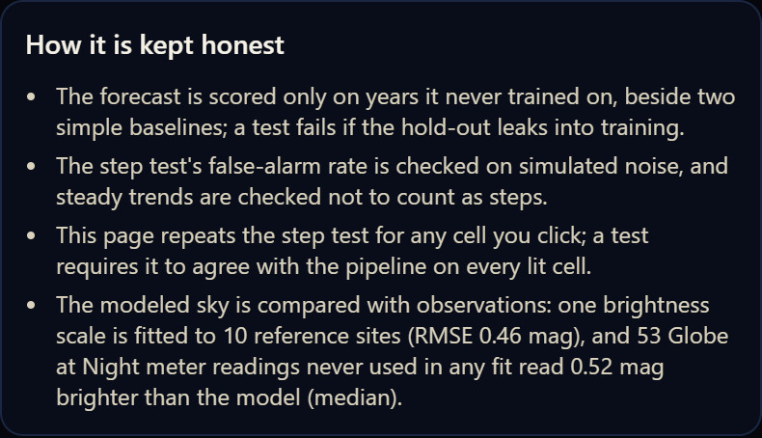
BACKUP · AI
How the AI is kept honest
Forecast scored only on years it never trained on; a unit test fails if they leak into training
Detector's false-alarm rate checked on simulated noise; steady trends must not count as steps
The web page re-runs the step test for any cell you click; it must match the pipeline on every lit cell
Sky model vs 53 Globe at Night meter readings never used in any fit: median 0.52 mag
The same checks, stated in the app's AI tab.
Jay Rosen · Restoring the Milky Way · UF AI Days · October 27, 2026
29
Notes:
[Backup, cut from the talk for time. To show it, type 29 and press Enter during the slide show.]
So how do we keep it honest? The forecast is only scored on years it never trained on, and a unit test fails if those years leak into training; we checked that the test catches a leaked version.
The detector's false-alarm rate is checked on simulated noise, and steady trends must not count as steps.
The web page re-runs the step test for any cell you click, and a test requires it to agree with the offline pipeline on every lit cell.
And the sky model is compared with 53 citizen-science meter readings that were never used in any fit. The model reads about half a magnitude darker than they do, and we publish that.

Slide 30
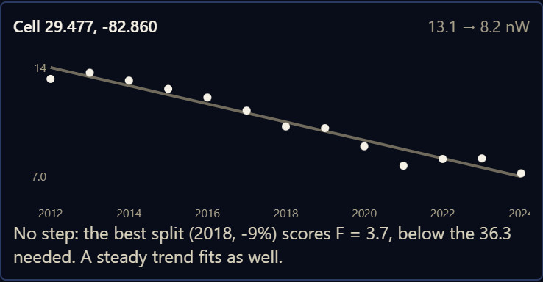
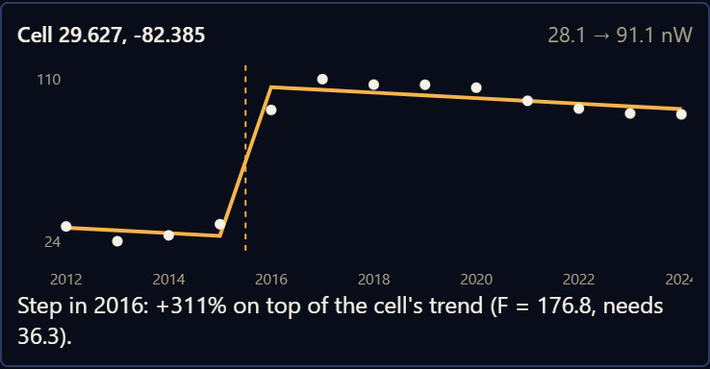
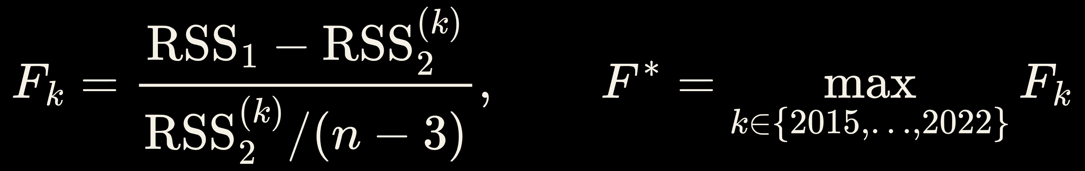
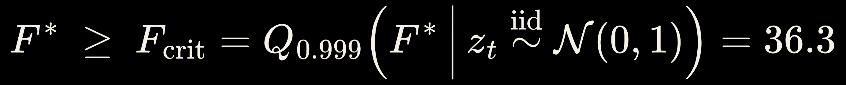
BACKUP · AI
Finding where lighting changed: trend or step?
For every lit cell: is a steady trend enough, or was there a sudden step?
F-test of line vs line + step, at the best of 8 split years (2015–2022)
Cutoff from simulating 200,000 noise-only cells: F ≥ 36.3, a false alarm 1 in 1,000
Region's shared movement removed first; steps must be ≥ 20%
Our first detector flagged 2,000 of 2,000 simulated steady trends
Steady trend: not flagged (Chiefland)
Step: flagged (I-75 & Archer Rd)
Jay Rosen · Restoring the Milky Way · UF AI Days · October 27, 2026
30
Notes:
[Backup, moved out of the talk for time. To show it, type 30 and press Enter during the slide show.]
To find where lighting changed, we test every lit cell with two explanations of its 13 yearly values: a steady trend, or a trend with a sudden step. On the left, a cell in Chiefland: a slow decline, no step. On the right, a cell that jumped in 2016.
An F-test measures how much the step helps, at the best of eight possible years. Picking the best year inflates the statistic, so the cutoff can't come from a textbook table.
Our first detector flagged two-thirds of all lit cells. In simulation it flagged 2,000 out of 2,000 cells that had nothing but a steady trend. A detector that flags everything tells you nothing.
So the cutoff now comes from simulating 200,000 cells of pure noise: F of at least 36.3, a false alarm one time in a thousand. The region's shared movement comes out first, so a cell is flagged for what happened there, and a step must be at least 20 percent.
[Reading the formulas, if asked]
Top, read: "F sub k equals R-S-S one minus R-S-S two, over R-S-S two divided by n minus three. F star is the maximum of F sub k." RSS is the error left after a fit: model one is the line, model two the line plus a step in year k. So F is how much error the step removes compared with the noise that's left, and F star is the best of the split years 2015 to 2022.
Bottom, read: "F star must be at least F crit: the 99.9th percentile of F star when the series is pure random noise, 36.3." Slide 32 has the full version.

Slide 31
BACKUP · AI
Forecasting growth with LightGBM
Gradient-boosted decision trees on ~30,000 one-km cells
Learns how fast a cell brightened over 6 years from 6 open inputs describing it at the start
Why not deep learning? Small tabular data: trains in seconds on a laptop, no GPU, reports what it relies on
What the model relies on (share of split gain)
300 trees · learning rate 0.05 · ≤ 31 leaves · ≥ 40 cells per leaf
Jay Rosen · Restoring the Milky Way · UF AI Days · October 27, 2026
31
Notes:
[Backup, moved out of the talk for time. To show it, type 31 and press Enter during the slide show.]
The second model forecasts growth. LightGBM, gradient-boosted decision trees, learns how fast each one-kilometer cell brightened over six years from what the cell looked like at the start, using six open inputs: distance to urban cores and major roads, housing density, elevation, conservation land, and current brightness.
It leans most on distance to urban cores, then housing density, elevation and current brightness.
Why not deep learning? About 30,000 cells, six tabular features, one number per cell. Boosted trees fit that well, train in seconds on a laptop with no GPU, and tell you what they rely on.
[Reading the formula, if asked]
Read: "F sub m of s equals F sub m minus one of s, plus eta times f sub m of s, where f sub m is the tree that minimizes the sum of squared leftovers." s is a cell's six inputs and r its growth rate. Each new tree is fitted to what the trees so far still get wrong, then added in at a learning rate, eta, of 0.05. After 300 trees, F is the model. Each tree has at most 31 leaves and at least 40 cells per leaf, which keeps it from fitting single cells.
The chart is each input's share of split gain: how much of the total error reduction came from splits on that input. Urban cores about 31 percent, housing density 22, elevation 21, current brightness 19, major roads 7, conservation land 1.

Slide 32
BACKUP · MATH
The step test, exactly
z = ln radiance minus the region's shared movement; n = 13 years; flagged if F* ≥ 36.3 and |step| ≥ 20%
F* is unchanged by shifting, tilting or rescaling a series, so one simulation of pure noise serves every cell
Expected chance flags: 0.001 × 28,986 ≈ 29; observed 1,493 (491 rising events, 144 falling)
Jay Rosen · Restoring the Milky Way · UF AI Days · October 27, 2026
32
Notes:
[Backup for questions about the change detector. To show it, type 32 and press Enter during the slide show.]
Line one, two models for one cell. z sub t is the cell's log radiance in year t, minus the region's shared movement. Read: "Model one: z sub t equals a plus b t plus epsilon." A straight line plus noise. "Model two, for split year k: the same line, plus d times one if t is at least k." The indicator is zero before year k and one from then on, so d is the step, in log units.
Line two, read: "F sub k equals R-S-S one minus R-S-S two k, divided by R-S-S two k over n minus three." RSS, the residual sum of squares, is the error left after each fit. The top is the error the step removes; the bottom is the noise left in model two, per degree of freedom: 13 years minus the three fitted numbers a, b and d. "F star is the maximum of F sub k over 2015 to 2022."
Line three, read: "F star must be at least F crit, the 0.999 quantile of F star when z is independent standard normal noise, which is 36.3." We simulated 200,000 noise-only series and took the value only one in a thousand exceeds.
One simulation serves every cell: both models contain a line, so shifting or tilting a series doesn't change F, and rescaling it scales the top and bottom alike.
A flagged step must also be at least 20 percent, up or down: e to the d, minus one. Results: 28,986 lit cells tested; about 29 would be flagged by chance; 1,493 were flagged, grouped into 635 events: 491 rises and 144 drops.

Slide 33
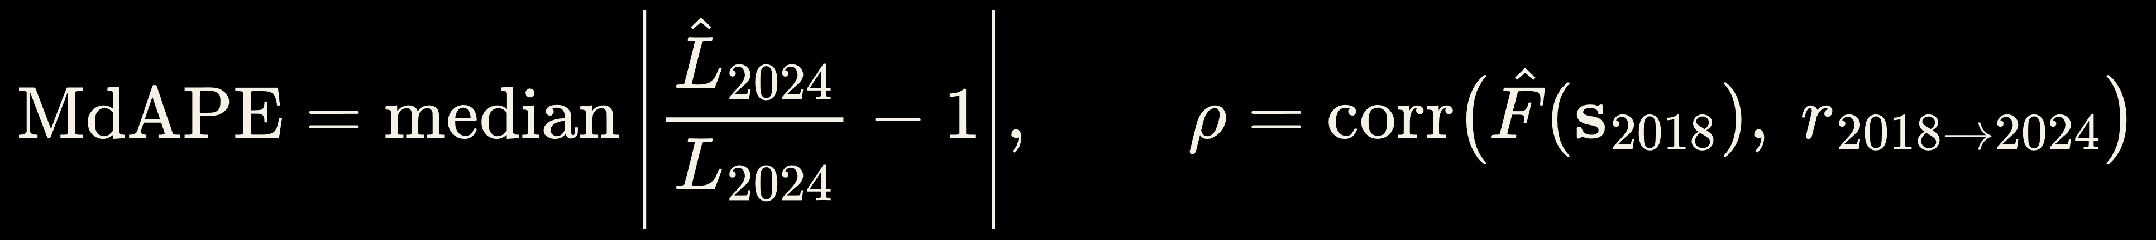
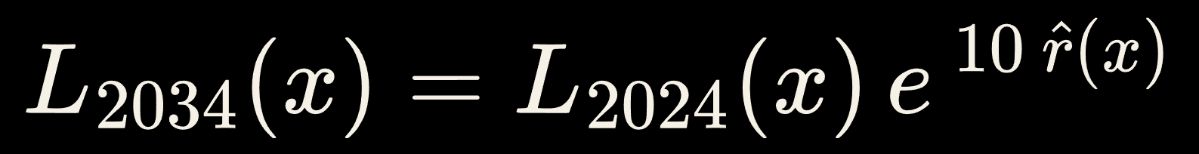
BACKUP · MATH
LightGBM: fit, back-test and forecast
Inputs s: distance to roads and urban cores, housing density, elevation, conservation land, ln radiance at the window start
Spatial check: 16 × 16-cell blocks in five folds → R² 0.18; forecast rate clipped to [−1%, +6%] per year
Jay Rosen · Restoring the Milky Way · UF AI Days · October 27, 2026
33
Notes:
[Backup for questions about the forecast. To show it, type 33 and press Enter during the slide show.]
Line one, the boosting step, read: "F sub m of s equals F sub m minus one of s, plus eta f sub m of s." s is a cell's inputs at the start of the window and r its average yearly growth in log radiance. Each tree fixes part of what the trees before it still get wrong: 300 trees, eta 0.05.
Line two, the back-test, read: "F hat is fitted from s 2012 to r, 2012 to 2018. L hat 2024 equals L 2018 times e to the six F hat of s 2018." Train on how each cell looked in 2012 and how fast it grew to 2018. Then give it the 2018 state, grow the 2018 brightness at the predicted yearly rate for six years, and compare with the real 2024, which the model never saw.
Line three, the scores, read: "M-D-A-P-E is the median of the absolute value of predicted over observed 2024, minus one. Rho is the correlation of the predicted rate with the real 2018 to 2024 growth." Results: 21.2 percent median error, the same as assuming no change, and a correlation of 0.35. It can't beat no change on totals, because lit areas fell 2012 to 2018 and rose 2018 to 2024, but it does rank where growth concentrates.
Line four, the forecast, read: "L 2034 equals L 2024 times e to the ten r hat." Refit on 2018 to 2024, apply to 2024, and carry that pace ten years, with the rate held between minus 1 and plus 6 percent a year. It's the recent pace carried forward, not a prediction.
Spatial check: hide 16-by-16-cell blocks in five folds and predict each from a model that never saw it: R squared 0.18.

Slide 34
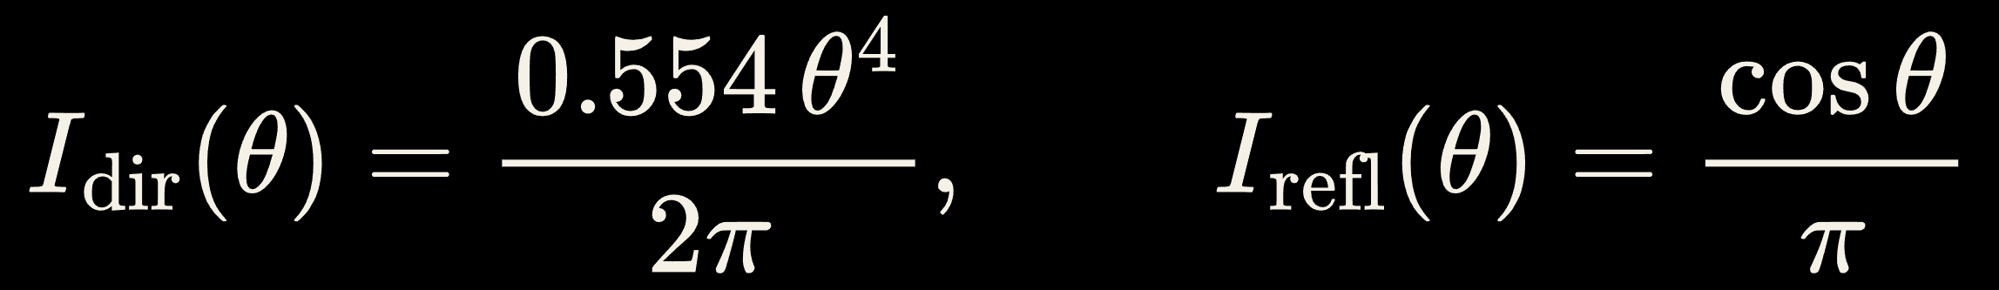
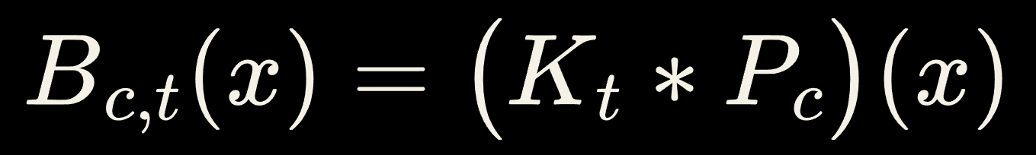
BACKUP · MATH
Skyglow physics: from a fixture to a magnitude
Rayleigh + Henyey-Greenstein aerosol scattering, slant-path extinction, Earth curvature; fitted within 7.4%
One global scale α fitted to 10 reference sites (RMSE 0.46 mag): a sanity fit, not a calibration
53 Globe at Night SQM readings never fitted: model reads a median 0.52 mag darker (0.21 after midnight)
Jay Rosen · Restoring the Milky Way · UF AI Days · October 27, 2026
34
Notes:
[Backup for questions about the sky model. To show it, type 34 and press Enter during the slide show.]
Line one, how a fixture sends light up, read: "I direct of theta equals 0.554 theta to the fourth over two pi; I reflected equals cosine theta over pi." Theta is the angle from straight up. Direct uplight grows as theta to the fourth, so most of it leaves near the horizon and travels far: that's why shielding matters most for distant skies. Light reflected off the ground spreads as cosine theta. The constants make each one sum to one over the sky.
Line two, the kernel: K of D is the zenith brightness from one lumen at distance D. Read: "the integral, up the line of sight, of I of theta times e to the minus tau r over h prime, over r squared; times beta R e to the minus h over H R times P R of psi, plus beta M e to the minus h over H M times P H G of psi; times e to the minus tau." In words: the light reaching height h, dimmed along its slant path and spread by the inverse square; scattered toward the observer by air molecules, the Rayleigh term, and by haze, the Henyey-Greenstein term, each thinning with height; then dimmed again on the way down. h prime adds Earth's curvature. A smooth curve fits the integral within 7.4 percent.
Line three, read: "B c t equals K t convolved with P c." Each layer is the kernel spread over where one group of lights sits, computed once, offline.
Line four, read: "L equals alpha times the sum of phi times B; m equals 12.6 minus 2.5 log ten of artificial plus natural brightness." The browser only re-weights the stored layers, and m converts candela per square meter to magnitudes per square arcsecond; the natural sky is 22.0.
Alpha is one scale fitted to 10 sites, error 0.46 magnitudes; 53 readings it never saw put the model a median 0.52 magnitudes darker.

Slide 35
BACKUP · Q&A
Prepared answers
Ground truth for change events? False-alarm rate set by simulation and tested; known openings line up (Celebration Pointe, Nov 2016). Next: utility work orders
Data leakage? Back-test trains on 2012 state and 2012–18 growth, predicts 2024 from 2018; a test feeds a 2018–24 jump and fails if the model could see it
Is the satellite blind to LEDs? Partly: VIIRS sees 500–900 nm. For the Groveland preset it records −24.9% where the eye sees −23.5%
Cost? Earth Engine's free noncommercial tier; the app is static files on free hosting
Didn't the County find +19%? That covered the whole 212 × 131 km map view (~20% in NOAA radiance); the county rose 3–6%
How good is the sky model? Scale fitted to 10 sites (RMSE 0.46 mag); 53 independent meter readings a median 0.52 mag brighter
Do not claim: calibrated sky brightness, a predicted 2034 sky (it is the 2018–24 pace carried forward), or that the detector finds retrofits
Jay Rosen · Restoring the Milky Way · UF AI Days · October 27, 2026
35
Notes:
[Backup with prepared answers. To show it, type 35 and press Enter during the slide show.]
Ground truth for the change events? The false-alarm rate is set by simulation and checked in tests, and known openings line up, like Celebration Pointe in November 2016. The next step is ground truth from utility work orders and Gainesville's streetlight records.
Data leakage? The back-test trains on 2012 conditions and 2012 to 2018 growth, then predicts 2024 from 2018. A test feeds it a 2018 to 2024 jump and fails if the model could see it.
Isn't the satellite blind to LEDs? Partly. VIIRS sees 500 to 900 nanometers, so it misses most of a white LED's blue. For the Groveland preset the satellite would record minus 24.9 percent where the eye sees minus 23.5.
What does it cost? The satellite pull runs on Earth Engine's free noncommercial tier, and the app is static files on free hosting.
Didn't the County find 19 percent growth? That came from two map screenshots covering the whole map view, from Perry to the St. Johns River, where NOAA's radiance rose about 20 percent. On the county boundary it rose 3 to 6 percent, and about 5 around Gainesville.
How good is the sky model? One brightness scale is fitted to 10 reference sites, error 0.46 magnitudes. Against 53 meter readings never used in any fit, readings are a median 0.52 magnitudes brighter than the model, 0.21 after midnight.
[Do not claim: a calibrated sky brightness; a predicted 2034 sky, since it is the 2018 to 2024 pace carried forward; or that the detector finds retrofits, since it misses most 20 to 40 percent drops.]

